Slide 1
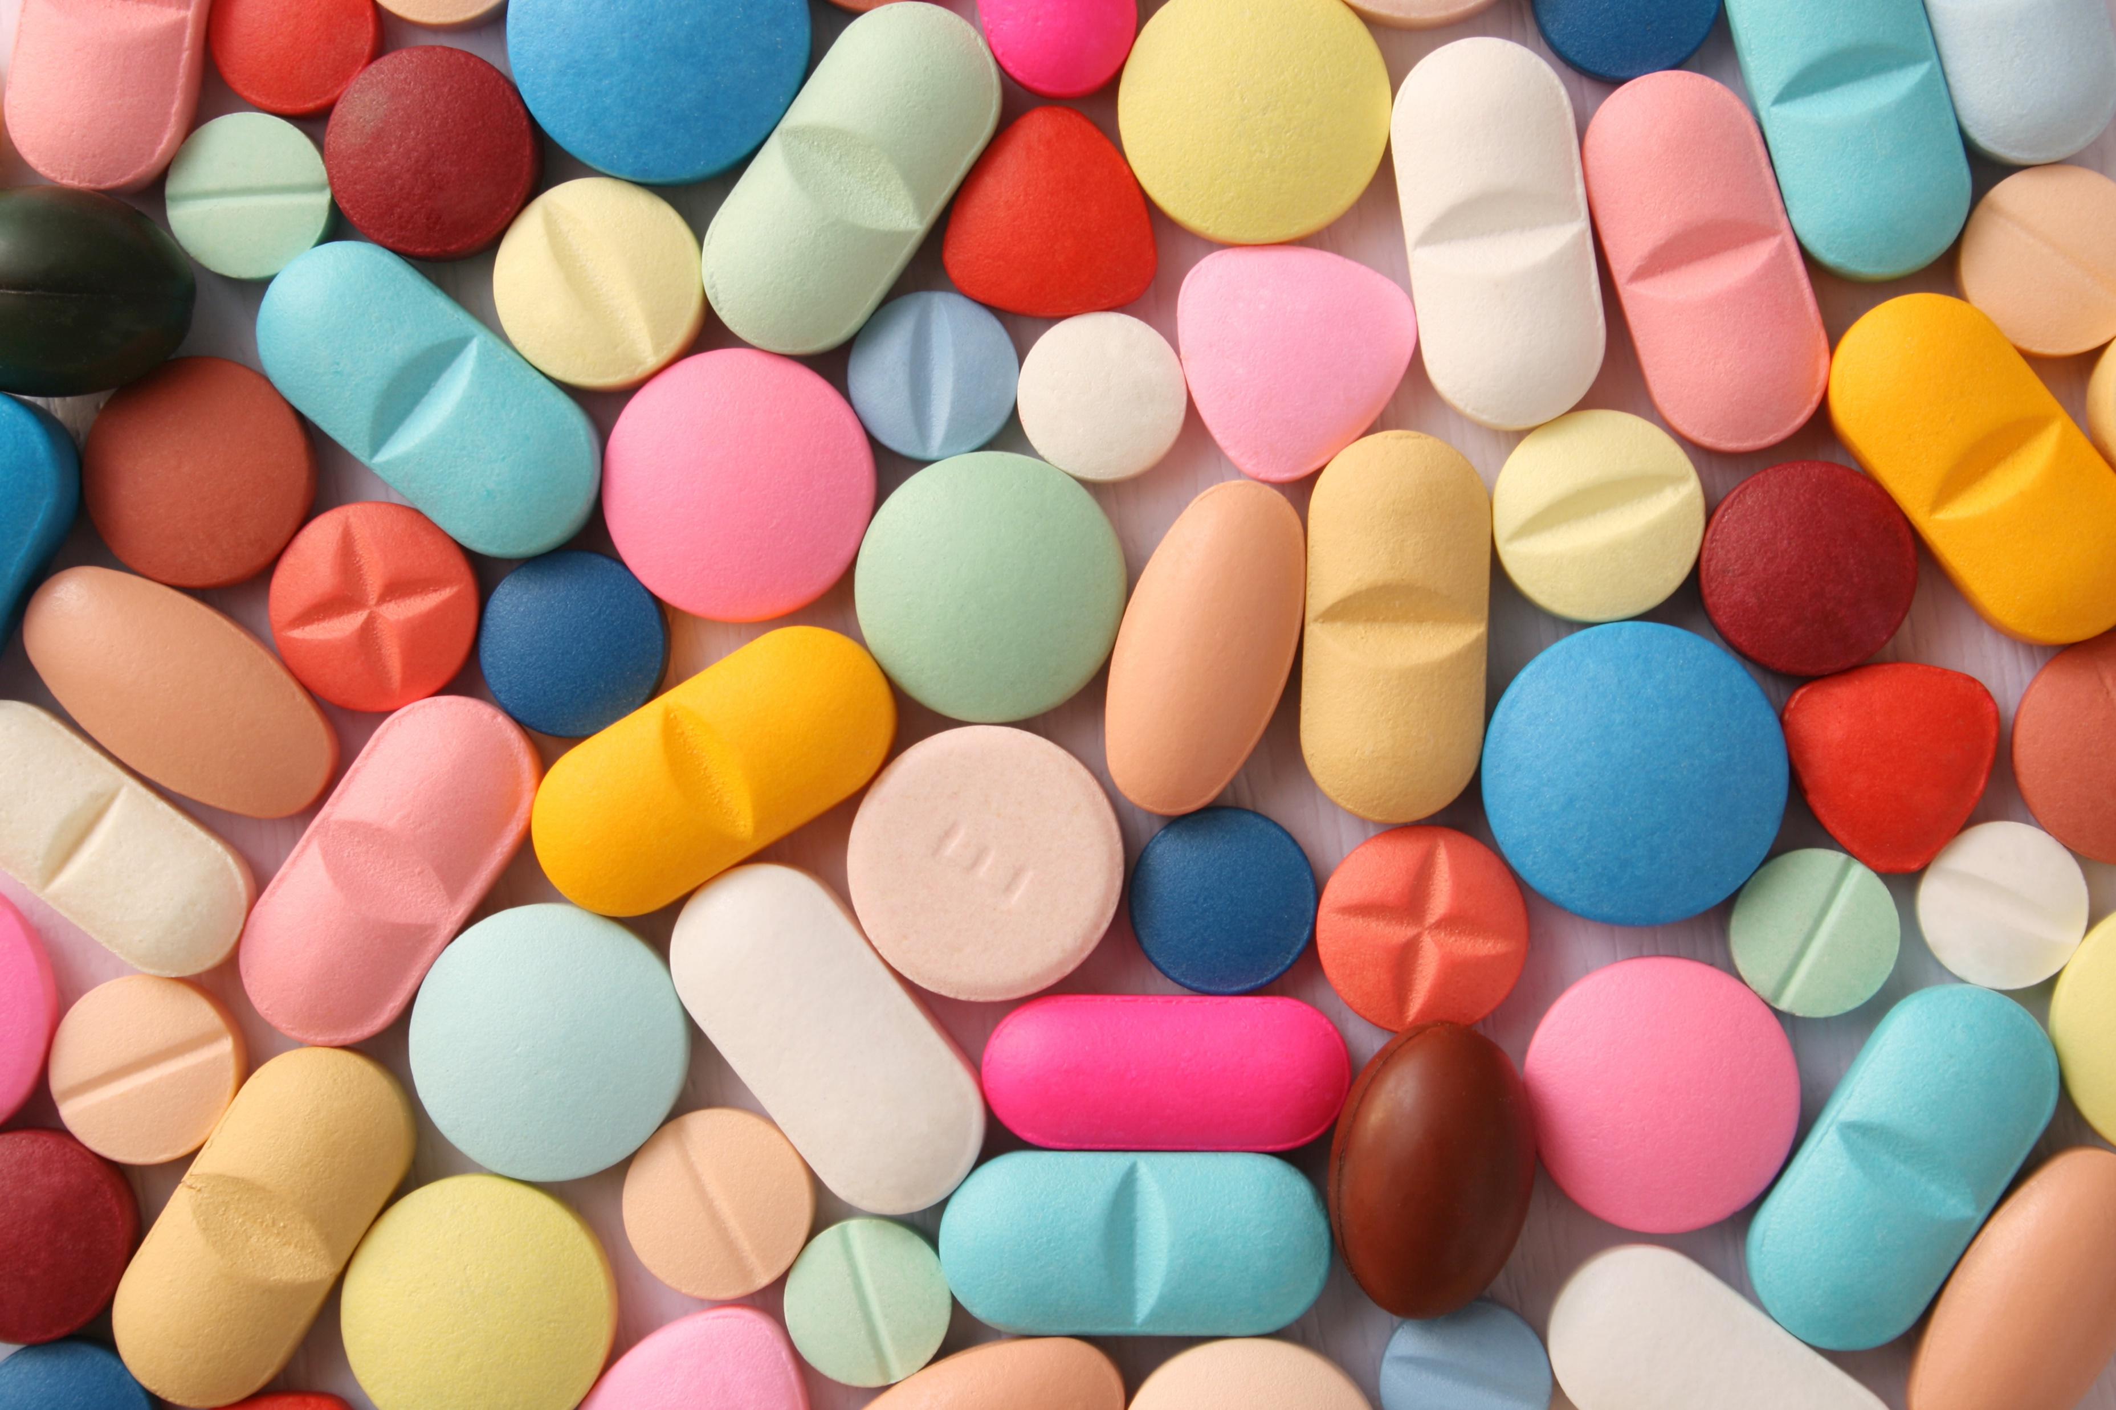
PHARMACOVIGILANCE:
Evidence-based Drug Safety Surveillance in Ayurveda
Prof. Anil Kumar Singh
( Co-ordinator, PPvC )
Head, Department of Dravyaguna
Faculty of Ayurveda, IMS, BHU, Varanasi

Slide 2
INTRODUCTION
Pharmacovigilance is the science and activities concerned with detecting, assessing, understanding, and preventing adverse reactions to medicines/drug with both short and long-term adverse effects.
It is an important and integral part of clinical research.
The ultimate goal is to improve the safe and rational use of medicines, thereby improving patient care and public health since most ADRs are preventable.

Slide 3
Need of Pharmacovigilance in ASU Medicines.

Slide 4
CONCEPTS IN AYURVEDA
Panchakarma vyapada
Concept of Viruddhahar
Dashavidha pareekshya bhava
Upashaya and Anupashaya
Shuddha and Ashuddha chikitsa

Slide 5
What is an Ideal drug?
Medicine should pacify the disease intended.
The administered dose should not create any other manifestation of diseases.
The opposite action of a medicine can categorize the treatment into Ashuddha Chikitsa

Slide 6
ओषधीर्नामरूपाभ्यां जानते ह्यजपा वने |
अविपाश्चैव गोपाश्च ये चान्ये वनवासिनः ||
- (च.सू. १/१२०)
यथा विषं यथा शस्त्रं यथाऽग्निरशनिर्यथा |
तथौषधमविज्ञातं विज्ञातममृतं यथा ||
- (च.सू. १/१२४)

Slide 7
A Vigilant Physician
Physicians need to be Vigilant throughout the treatment for both the patient condition and the disease stage.
This Vigilance avoids confusion about disease or treatment.

Slide 8
भेषजं केवलं कर्तुं यो जानाति न चामयम् । वैद्याकर्म स चेत्कुर्यादधमर्हति राजतः ।।
यस्तु केवलरोगज्ञो भेषजेष्वविचक्षण: । तं वैद्यं प्राप्य रोगी स्याद्यथा नौर्नाविकं विना ।।
यस्तु केवलशास्त्रज्ञ: क्रियास्वकुशलो भिषक् । स मुह्यत्यातुरं प्राप्य तथा भिरुरिवाहवम् ।।
यस्तु रोगविशेषज्ञ: सर्वभैषज्यकोविद: । देश कालविभागज्ञस्तस्य सिद्धिर्न संशय: ।।
आदावन्ते रुजां ज्ञाने प्रयतेत चिकित्सक: । भेषजानां विधानेन ततः कुर्यात्चिकित्सितम् ।।
- (भा.प्र. पूर्व.ख. ६/१७-२१)

Slide 9
How ADRs can be developed?
Drug when administered in more or less quantity
Administered in inappropriate time
Improperly processed drug
Improperly metabolized drug

Slide 12
Possible causes of ADRs
Poor Product Quality
Improper Administration of Drug
Inadequate Regulatory Measures
Largely Uncontrolled Distribution Channels
Weak Quality Control System

Slide 13
Some Reported ADRs of Ayurvedic Herbs.
Senna – Dermatitis
Garlic – Hypoglycemia when used with anti-diabetic drugs
Ginseng – Bleeding complaints, insomnia.
Guggulu – Vertigo
Bhallataka – Whole body rashes
Vatsanabha – Cardiac problems
Indrayana – Gastric irritation

Slide 14
Adverse effects of some common Ayurvedic products
Chyawanprasha- Promote tooth decay, if made from unripe
amla, and can cause sore throat also.
Triphala Churna- Stomach irritation including diarrhea, intestinal
gas and general stomach upset.
Changes in Blood Cholesterol and Blood Sugar
Ashokarishta- Delayed periods and prolonged menstrual cycles.
Dashamularishta- A high dose may cause a burning sensation &
stomach disturbances

Slide 15
Arogyavardhini vati - Both Guggul and Neem pose the greatest risk for
side effects when taken at high doses.
- Guggula - stomachaches, headaches, nausea, vomiting,
diarrhea, and rashes.
- Neem - kidney damage
Shilajit - It increases the production of uric acid in the body
and can thus worsen gout.
Lavana Bhaskara Churna- Overdose can lead to burning
sensation & stomach disturbances.

Slide 16
CONCLUSION
Ayurveda treatments are safe and well-tolerated usually when prescribed by a qualified and knowledgeable Ayurvedic practitioner.
Ayurveda Shastra approaches the patient with keen observation and constant vigilance through the Roga pareeksha factors like Pancha Nidanadi rupa.
The concept of Upashaya and Anupashaya depicts the treatment based on the Prakriti of each patient.
There are clear concepts regarding the raw material collection onward the processing and administering of the drug with clear mention of Kala as the dominating factor

Slide 17
The Do’s and Don’ts if followed make the patient and the physician on the safer side.
Panchakarma Chikitsa mentioned has to be followed as a manual for the applied aspects.
Under the If’s and But’s, there is immense space for the physician to apply his Yukti for the betterment of the patient also.
Actual blame for ADRs lies on the manufacturers of Ayurveda drugs who have the eye only on the quick profit & on the negligence of people who consume OTC Herbal products without understanding the risks associated with them.

Slide 18
THANK YOU
For listening Patiently……...

