Slide 1
Dr. Rohit Sharma
Assistant Professor,
Dept of Rasashastra & Bhaishjya Kalpana
FoA, Institute of Medical Sciences,
Banaras Hindu University, Varanasi-221005, India.
rohitsharma@bhu.ac.in/ dhanvantari86@gmail.com
+91 9816724054

Slide 2
Pharmacovigilance
Pharmakon (Greek): Drug
Vigilare (Latin): To keep awake or
To keep alert or
To keep watch

Slide 5
Notes:
ADR def given by WHO (in 1972)

Slide 6
Adverse Drug Reactions (ADR)
Causes: Overdose (poisoning)
Drug Abuse
Therapeutic errors
Common Types: 1. Type A (Drug reactions)
-Depends upon pharmacological properties of Drug.
-Predictable, Common, Dose-related, Preventable,
E.g. Hyper/Hypo response, Side effects (under therapeutic dose), Toxic effects (due to overdose)
2. Type B (Patient reactions)
-Depends upon the peculiarities/intolerance of patients
-Unpredictable, Rare, Not dose-related
E.g. Allergy (Immunological),
Idiosyncrasy (genetic/unknown cause)

Slide 7
Another Classification (based on cause & severity):
Type A: Augmented (increased/enlarged therapeutic effects e.g. thrombocytopenia or tremors (valproate))
Type B: Bizarre (strange/peculiar effects, e.g. allergic rashes)
Type C: Chronic (Complicated effects, time & dose related,
e.g. Analgesic nephropathy)
Type D: Delayed (only time related, e.g. Carcinogenesis)
Type E: End-of-treatment effects
Type F: Failure of therapy effects

Slide 8
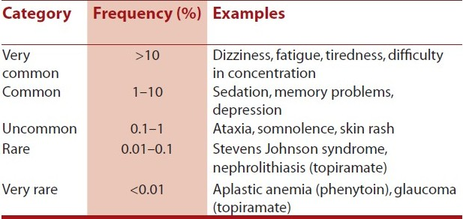
Another Classification (based on the frequency of occurrence):

Slide 11
Signal - Reported information on a possible causal relationship between an adverse event and a drug, the relationship being previously unknown or incompletely documented. (WHO) - Usually more than a single report is required to generate a signal, depending upon the seriousness of the event, and the quality of information.

Slide 12
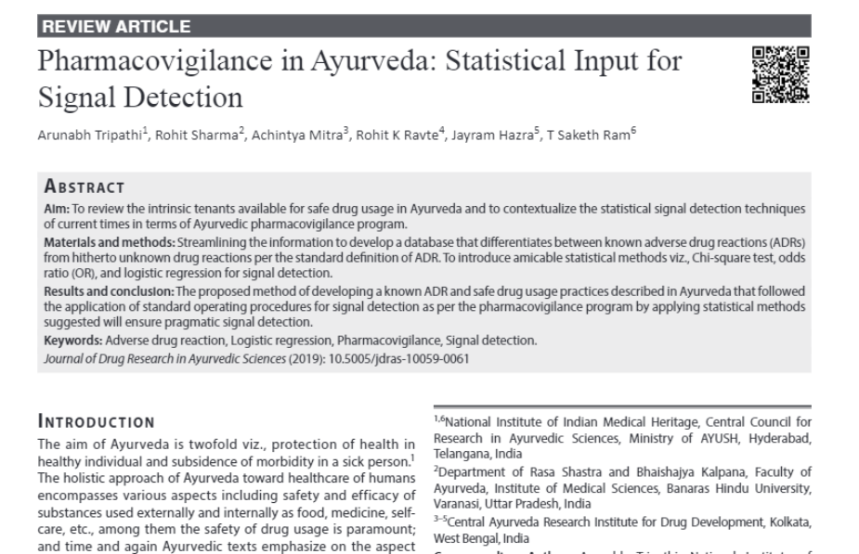

Slide 13
A Glimpse of History in Pharmacovigilance
1848
Hannah’s death caused by chloroform
1965
European legislation was developed
1937
USA with the solvent diethyl glycol
1968
WHO program for International Drug Monitoring was instituted
1938
Federal FDC Act was established
Historical evolution of Pharmacovigilance
1995
EMA(European Medicines agency) was set up
1955
Gastrointestinal toxicity of aspirin(ASA) was proved
2001
Eudra Vigilance was funded
1961
McBride’s Letter about the tragedy of Thalidomide
2012
New European Pharmacovigilance Legislation
1964
Yellow card was structured in the UK
2017
New Eudra Vigilance Format

Slide 14
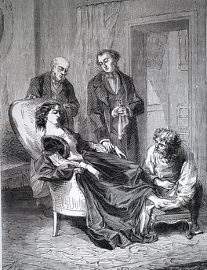
Chloroform anesthesia
Hannah Greener of 15 years old, suddenly dies off
when anesthesia was given for removing
infected toe nail.
She dies with cardiac arrhythmia and aspiration
which led to Fibrillation.
This happened in 1848, Jan 29, in Winlaton, England.
The Lancet journal engaged a commission with
Dr. Lauder Brunton in 1889 to report such anesthesia complications.
1893 – the results of this survey was published which became the first trigger in the pharmacovigilance history.
1848-1893

Slide 15
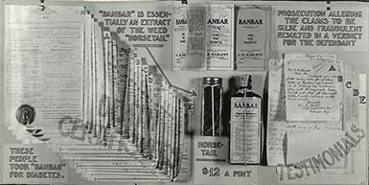
US Federal Food & Drug ACT
Formed on June 30, 1906
Objective- Drug to be pure and free
from contamination
1911, prohibited the false therapeutic
indication of drug
Banbar’s decoction
Adulterated
Misbranded
Poisonous
Deleterious
Notes:
The first federal law in the United States to protect consumers from unsafe and misbranded food and drugs

Slide 16
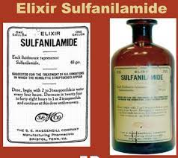
Sulfanilamide Elixir
1937
The Diethylene glycol (DEG) turned to be
poisonous when used as a solvent.
Haitian Disaster- More than 105 deaths
Acute renal failure and death
Sore throat
Dr. A.S. Calhoun’s patients
Massengill Co.
DEG
Syrup

Slide 17
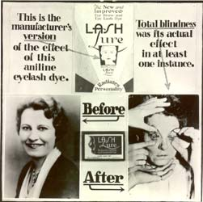
Food, Drug and Cosmetic Act-1938
History begins …………..
President – Franklin D Roosevelt- signed to form the FDCA Law, June 25th
Regulated by FDA under the US Department of Health and Human Services
Approval of new drugs, medical devices, etc.
Regulate the advertising and labelling
Inspect and Mandate the safety and efficacy of drugs
Notes:
The introduction of this act was influenced by the death of more than 100 patients due to Elixir sulfanilamide. The FDCA is a set of laws passed by the United States Congress in 1938 giving authority to the U.S. Food and Drug Administration (FDA) to oversee the safety of food, drugs, medical devices, and cosmetics.

Slide 18
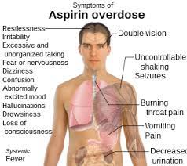
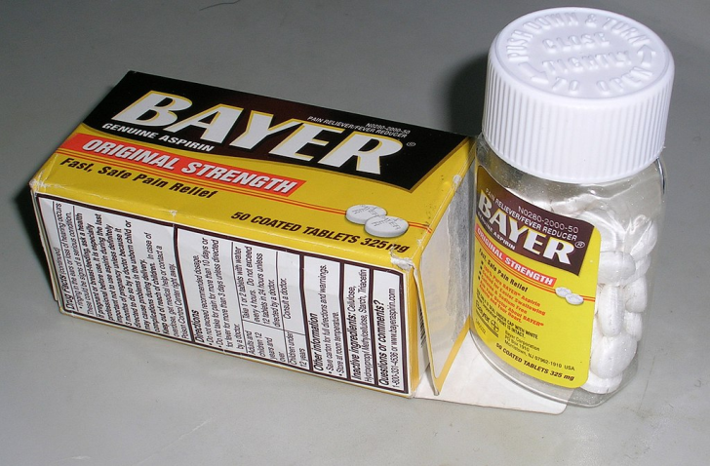
ASA toxicity
A.H. Douthwaite supposed that ASA could cause Melena
1938
1955
Supposed to be given with stomach protective agents

Slide 19
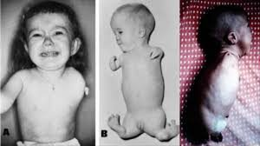
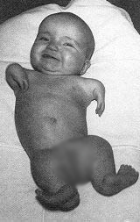
Thalidomide Tragedy
1961: ‘The biggest anthropogenic medical disaster forever ’
Notes:
During post war era- tranquilizers developed in the 1950s by the West German pharmaceutical company Chemie Grünenthal GmbH.
An OTC remedy gradually used for cold, flu, nausea and morning sickness in pregnant ladies
Dr Widukind Lenze and Dr William Mcbride published the results.
Dr. Frances Kelsey credited for not approving the drug in America.
FDA approved it for treatment of leprosy and multiple myeloma.

Slide 20
Yellow card to Pharmacovigilance
1962- USA made mandatory Teratogenicity testing of New formulations in three different animals before marketing submission
1964-Yellow card :- a form for Spontaneous reporting of Adverse Reactions with cause effective relationship implemented in UK
1965- European Legislation with EC Directive 65/65
1966- Pilot study -Boston Collaborative Drug Surveillance Program

Slide 21
WHO Program
1968- International Drug Monitoring
1975- Italy joined the
movement
1982
1992-European Society of Pharmacovigilance (ESoP) International Society of Pharmacovigilance (ISoP)
1995- EMA(European Medicines Agency)
2001- Eudra Vigilance Database
2012- New European Pharmacovigilance Legislation
2017- New Eudra Vigilance Format
10 members- Australia, UK, USA, Germany, Canada, Ireland,
Sweden, Denmark, New Zealand, and Netherlands
Many studies of observed ADR conducted
UMA – Uppsala Monitoring Centre. Sweden
Vigiflow- Software

Slide 22
Pharmacovigilance in India
1986 - 12 regional centers - Formal ADR monitoring system
1989 - 6 Regional centers Mumbai, Kolkata, Delhi, Lucknow, Pondicherry, Chandigarh
1998 - WHO program for International Drug monitoring
2004 -launched with support of World Bank NPP (National Pharmacovigilance Program) (AIIMS)
2005- January 1- Started functioning
2009 – suspended (Lack of funding)
2010 CDSCO- Pharmacovigilance Program of India
2011 IPC- as the National Coordinating Centre
New Delhi – National Center
Mumbai-
WHO Special Center

Slide 23
Pharmacovigilance of Traditional Medicines
2004 Guidelines for PV in Traditional medicine was published from WHO
2006 Workshop- Mumbai “ Pharmacovigilance of Ayurvedic Medicine”
2007 October Seminar/Workshop- BHU “ Safety Profile of Ayurvedic Dosage forms”
2007 December -Workshop-IPGTRA Implementation possibilities of Pharmacovigilance in Ayurveda
2008 August - New Delhi Draft Protocol discussion
2008 September - Draft finalizing IPGTRA, Jamnagar as National Resource Centre
2017 Central Sector Scheme AIIA -NPvCC, 5 IPvCC, 99 PPvCC
2022 AOGUSY- AYUSH OUSHADHI GUNVATTA EVAM UTTPADAN SAMVARDHAN YOJANA
Notes:
2004: WHO emphasized to include TM in PV system, published guidelines on safety monitoring of herbal medicine.
2006: 2-day workshop – ‘Pharmacovigilance of Ayu. Med.’,
Idea of NPP for traditional medicines began
2007: 2-day workshop IPGT&RA, Jamnagar,
based on recommendations of workshop:
- PV-Cell established,
Reporting form for suspected ADRs of ASUD developed
2008: Draft analyzed, discussed in AYUSH, Draft Finalized,
NPP of ASU medicines launched,
IPGT&RA–NPRC, 2009-10 –prog. reviewed

Slide 24
AOGUSY Ayush oushadhi gunavattva evum uttpadan samvardhan yojana
Central sector scheme for ASU& H under Ministry of AYUSH from November 1, 2017 approved by the Standing Finance committee chaired by Secretary (AYUSH)
33 Tier Network
National Pharmacovigilance Centre (NPvCC)
All India Institute of Ayurveda, New Delhi
Intermediary Pharmacovigilance Centre (IPvCCs)
5 National Institutes
Peripheral Pharmacovigilance Centre (PPvCCs)
More than 99 AYUSH Institutions with Clinical Facility

Slide 25
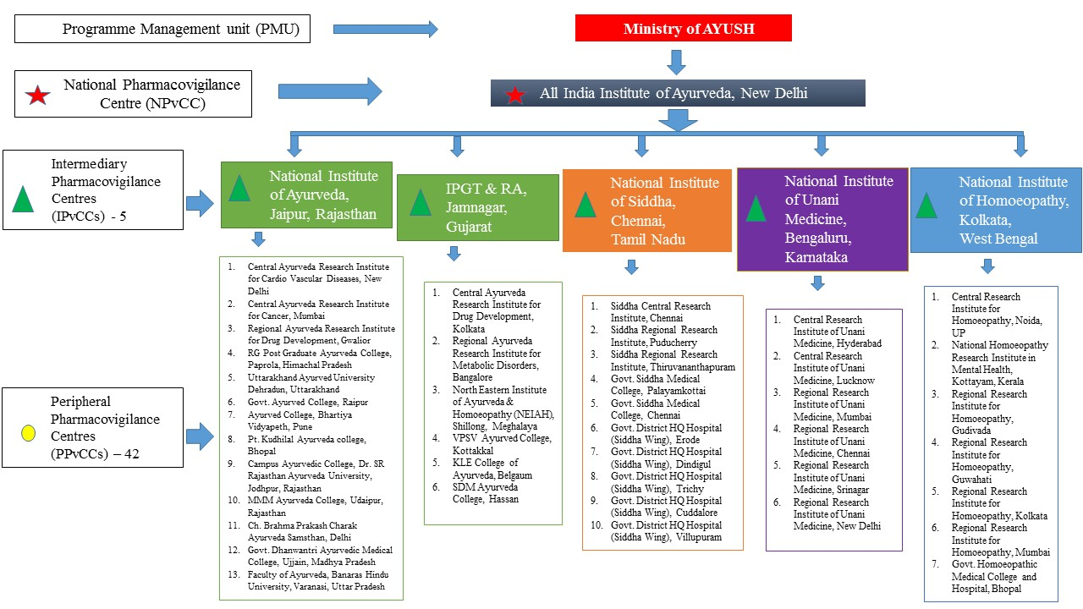
Hierarchy
Pharmacovigilance in ASUDs
(Approved centres)
99 PPvC

Slide 26
Operational Framework
(for implementation of PV Program)
Steering & Monitoring Committee
Technical Advisory Committee
Central Signal Detection & Causality Assessment Committee:

Slide 27
Steering & Monitoring Committee
Head, DCC, Ministry of AYUSH
Director/Co-ordinator from NPvCC, AIIA
Coordinator from IPvCC
Representative from CDSCO
Representative from IPC
Representative from PCIM&H
Technical Advisory Committee
Chairman of Scientific Body of PCIM&H
Chairmen of APC, UPC, SPC and HPC
Head, DCC, Ministry of AYUSH
Director/Co-ordinator from NPvCC, AIIA
Representative from IPC
Representative from CDSCO
Pharmacology expert from AIIMS/ ICMR
WHO representative of PV Prog.
Central Signal Detection & Causality Assessment Committee
Coordinator of NPvCC
AYUSH clinical expert
Pharmacy expert of AYUSH system
Pharmacology / Toxicology expert

Slide 28
Ayushsuraksha
a AYUSH pharmacovigilance reporting site for adverse drug reactions (ADRs)
(www.ayusuraksha.com)

Slide 29
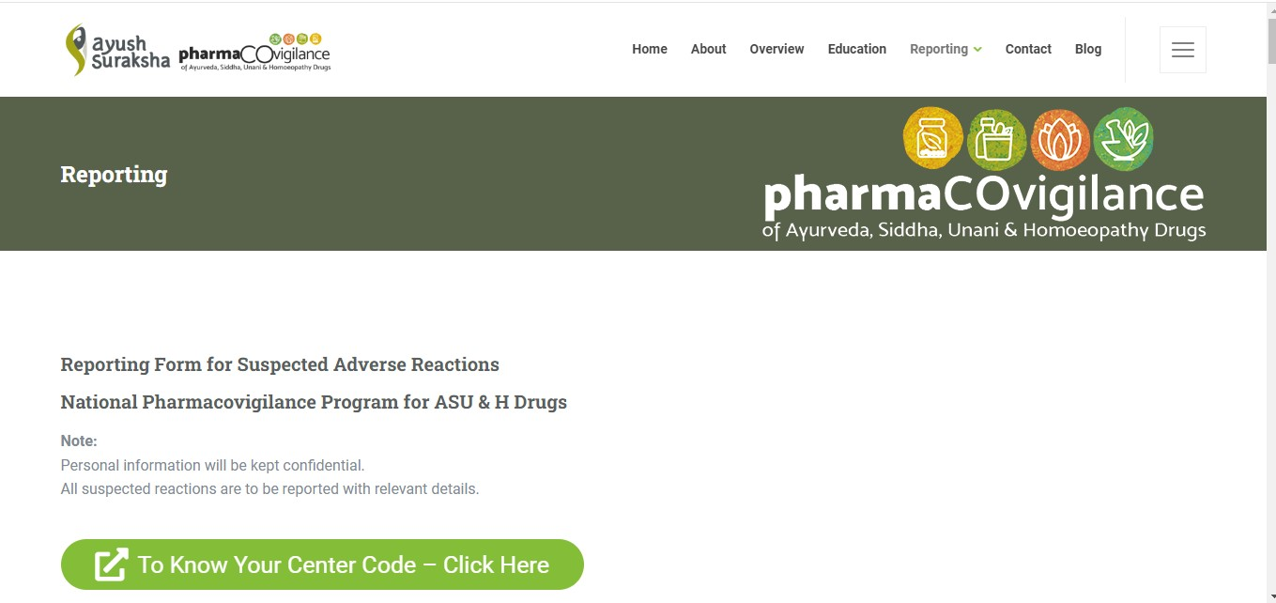

Slide 30
National Pharmacovigilance Programme for ASU (NPP-ASU)
Need???
All drugs of “natural” origin are “safe”!!!
‘NO’
Improper use/ self medication
Sometimes used with other medicines- drug interactions!!!
Adulteration or contamination with allopathic medicines
Poor product quality
Notes:
ASU drugs are considered as safe drugs. This perception is likely to change in the light of some recent incidences of ADRs during their use.

Slide 32
Prime Objectives
Detection/ documenting adverse effects (of potentially unsafe ASU&H medicines): to collect, collate and analyze data to establish evidence for clinical safety of ASUDs in a scientific manner
To undertake safety monitoring of ASU drugs
Surveillance of misleading advertisements of ASUDs appearing in the print and electronic media and take regulatory actions.
‘Reporting’
Suspected ADRs, (II) Misleading Advertisement

Slide 33
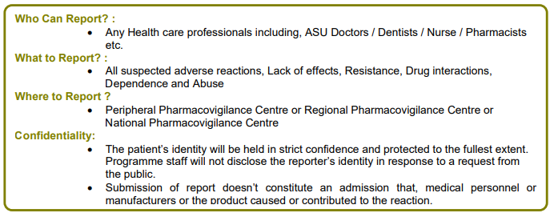
Reporting

Slide 34
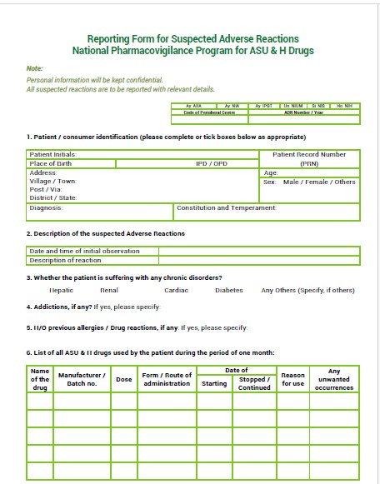
Sample ADR form

Slide 35
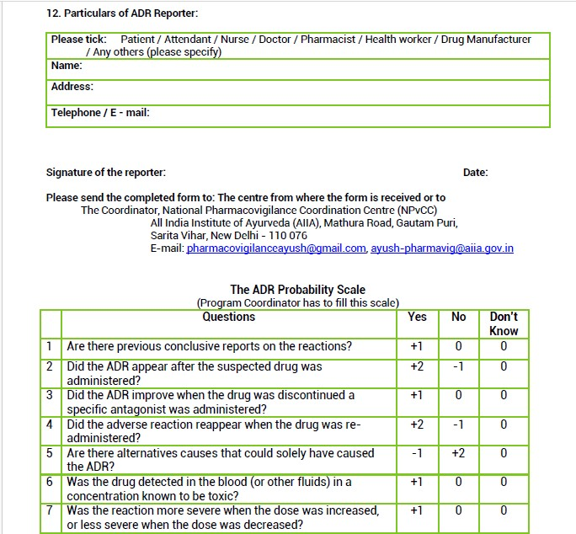
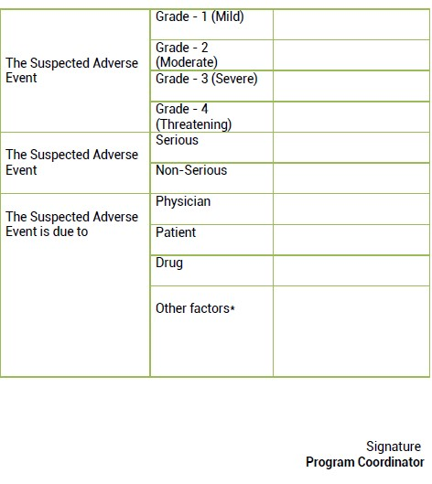

Slide 36
Flow of Information
Health Professionals
Peripheral Centre
(collection)
Intermediary Centre
(collection)
National Centre
(casualty / Statistical analysis, Advisory committee review the data, may suggest regulatory intervention)
Ministry of AYUSH
Info sent using MedDRA / WHO ART terminology
WHO Uppsala Monitoring Centre
[International ADR Database,
‘Vigibase’ (WHO Global ICSR database)]

Slide 39
Misleading Advertisements Regarding AYUSH Medicines
Drugs and Magic Remedies (Objectionable Advertisements) Act, 1954 !!
Steps taken by Central Government:
State Governments have been directed for appointing Gazetted Officers : to enter, search any premises or examine or seize any record which contravenes any provisions of the Act.
Complaints of misleading advertisements of ASUDs are forwarded to the concerned State Licensing Authorities.
MoU : Ministry of AYUSH + Advertising Standards Council of India (ASCI): to undertake monitoring of the misleading AYUSH –related advertisements appearing in print and TV media and bring the instances of improper advertisements to the notice of the State Regulatory Authorities for taking necessary action.
On request of Ministry of AYUSH, Ministry of Information & Broadcasting issued an advisory to all media channels to ensure strict compliance of the provisions of D&C act 1940 & D&MR act 1954.
Surveillance of AYUSH advertisements for safety monitoring of ASUDs

Slide 40
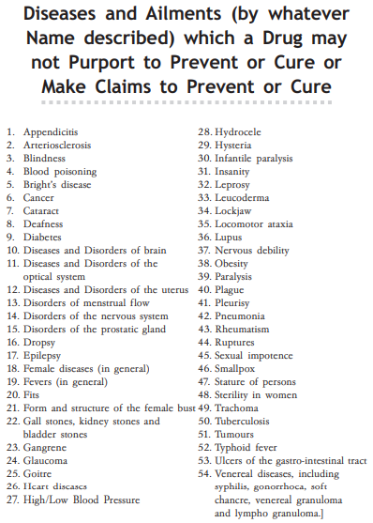
78
Notes:
The 2020 Amendment in DMR, 1954 has added to the 54 diseases, those from Schedule J inclusions and altogether the number of diseases has been now increased to 78.

Slide 41
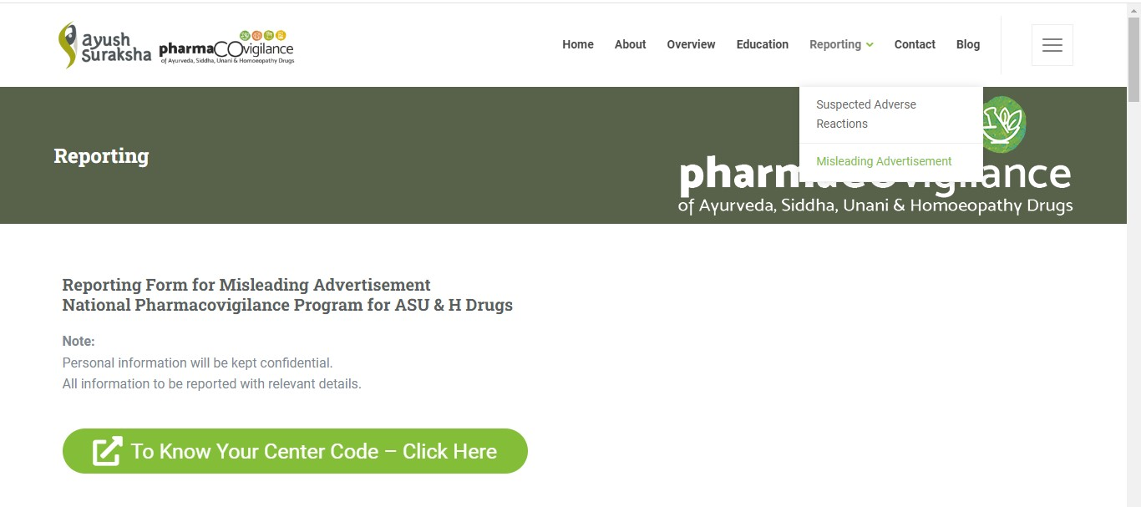
Notes:
The Submission against Misleading can be now done in Online mode, or by downloading the Word/ PDF submission format and sending to the respective Peripheral Pharmacovigilance Unit.

Slide 42
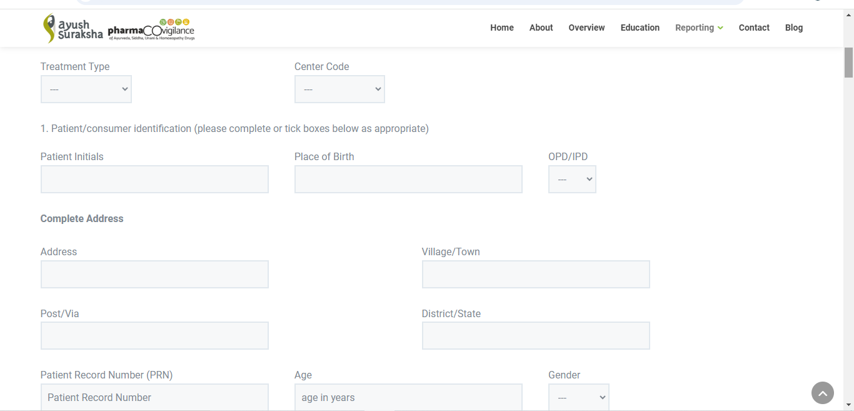

Slide 43
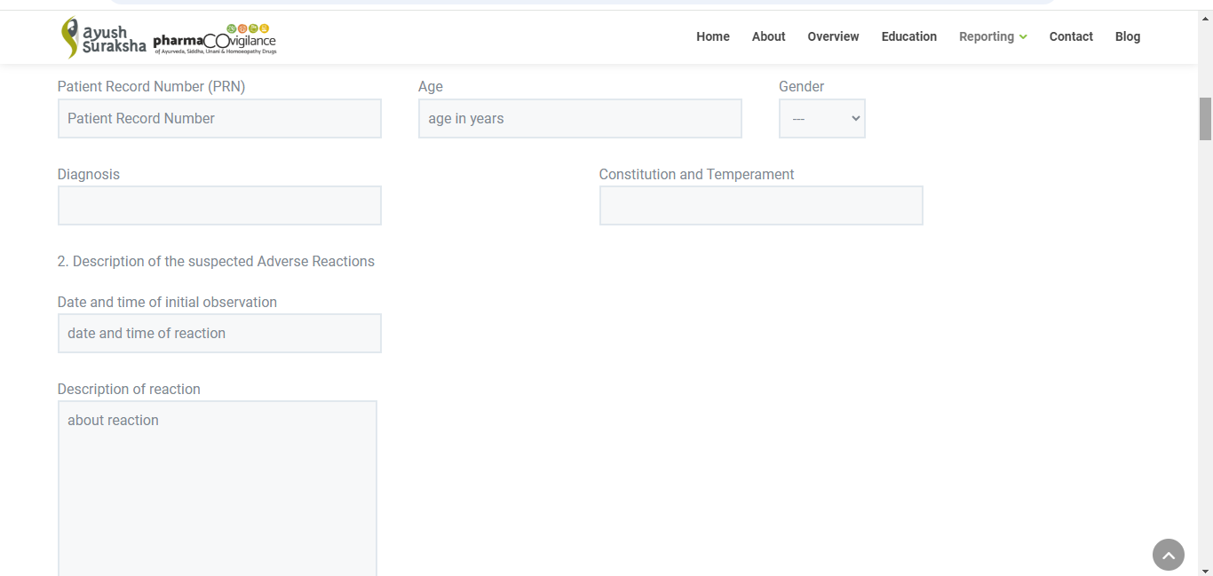

Slide 44
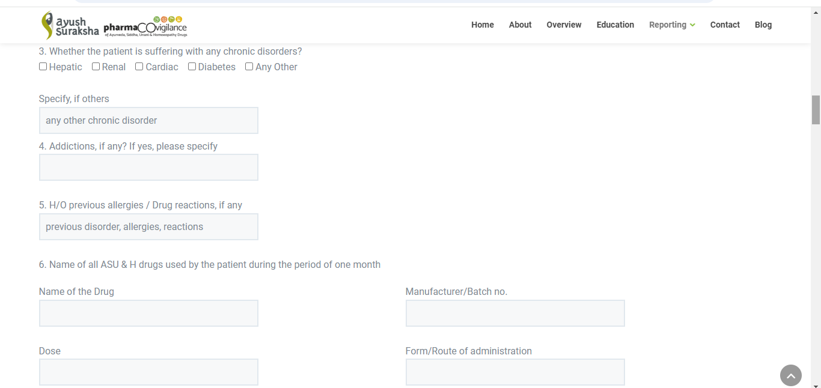

Slide 45
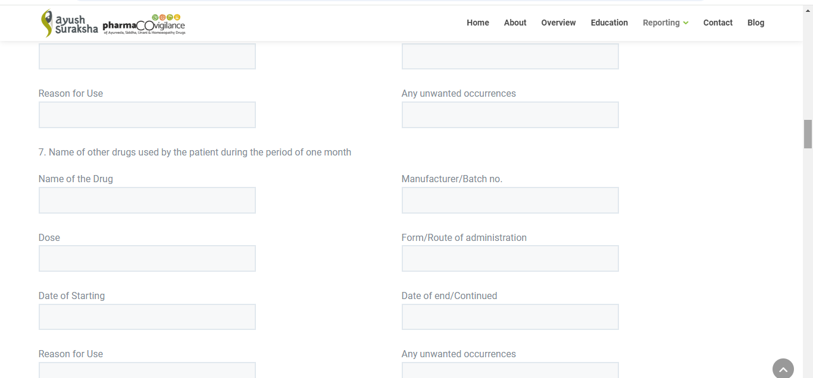

Slide 46
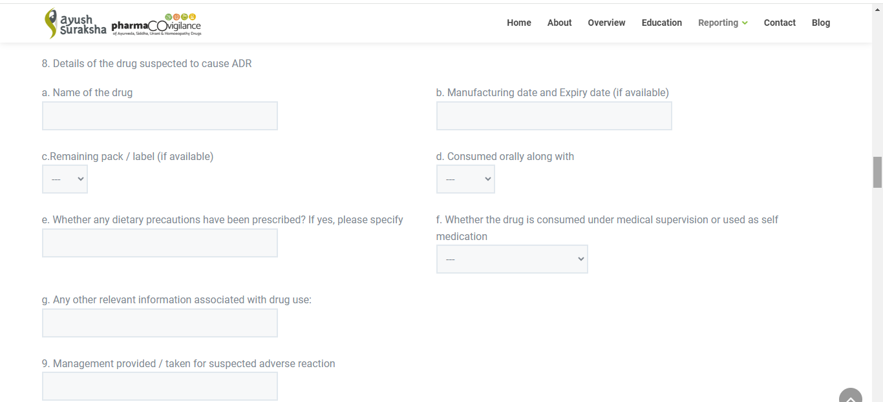

Slide 47
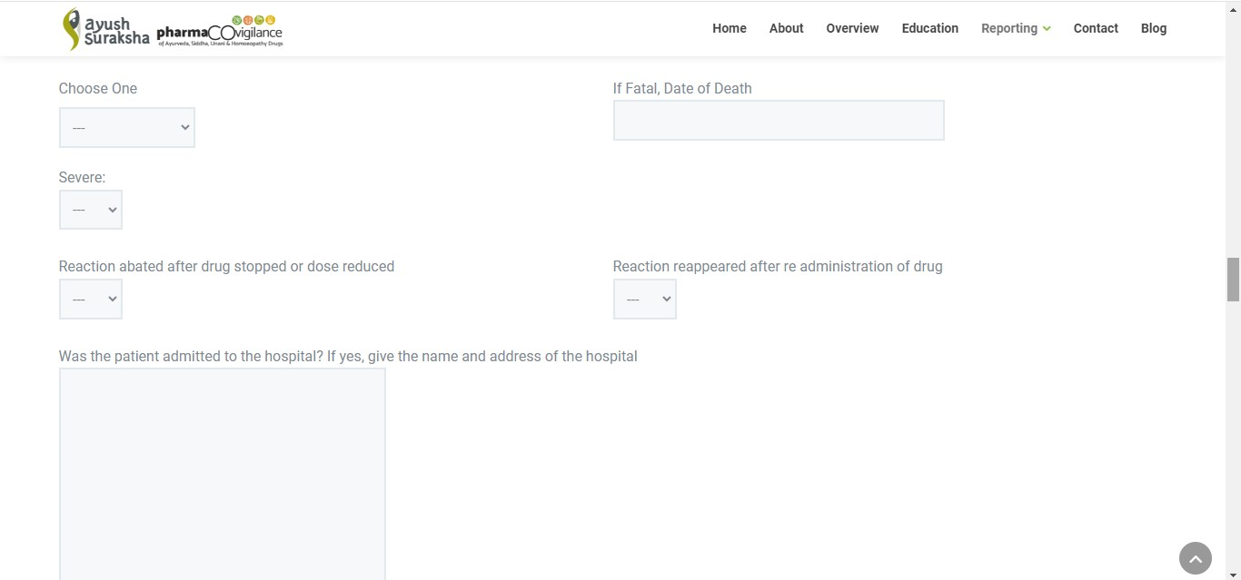

Slide 48
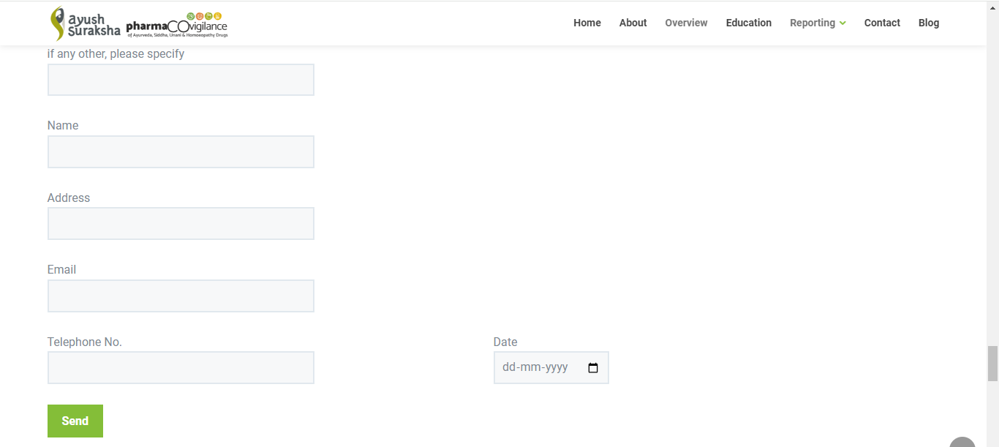

Slide 49
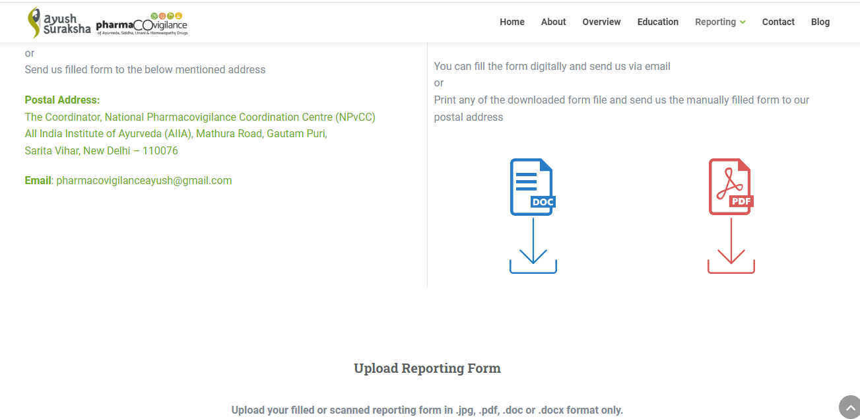

Slide 52
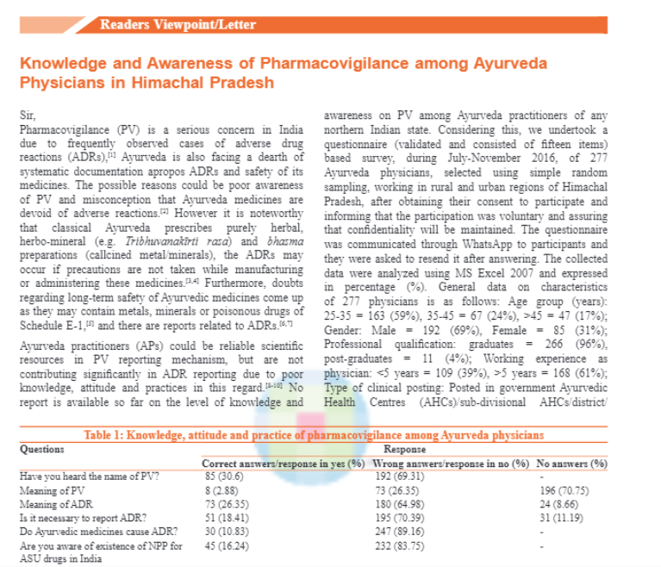

Slide 53
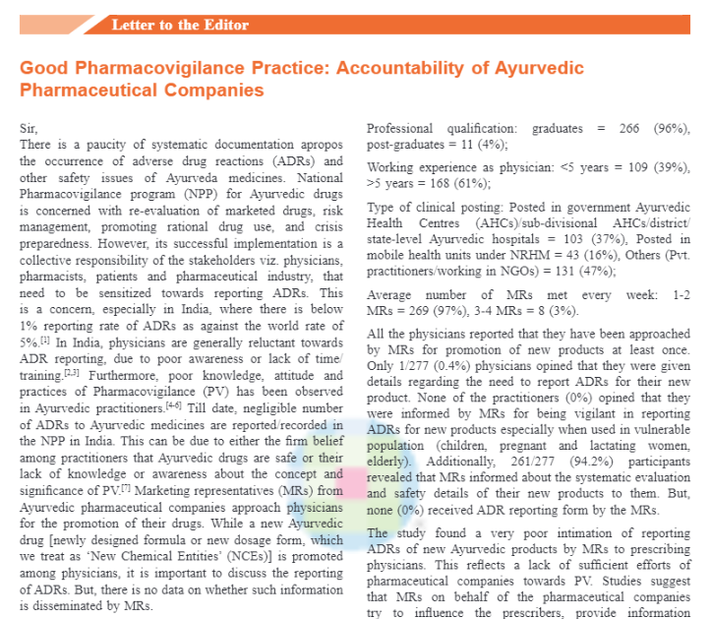

Slide 54
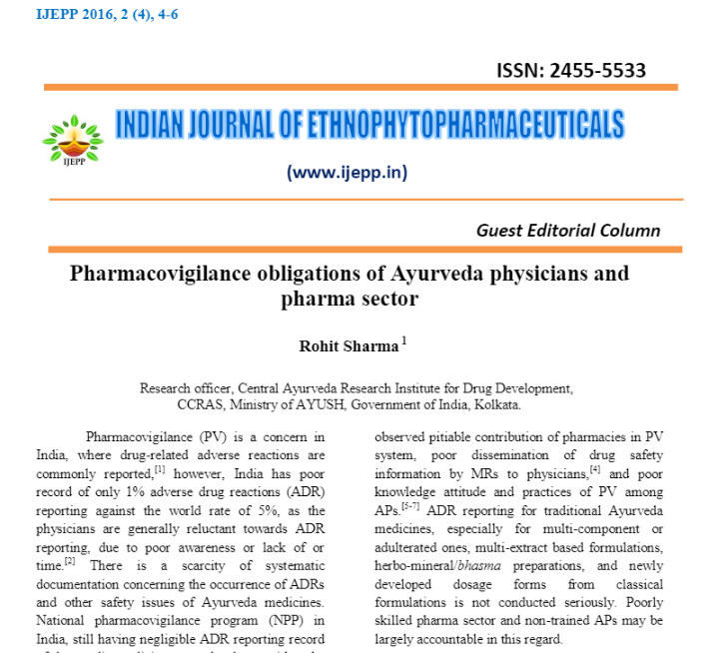

Slide 58
For better PV practice in ASUDs
• Strengthen education, training and publicity.
• Revitalization of an effٴective Pharmacovigilance system for ASU drugs
• Strengthen the roles of pharmaceutical manufacturers as the main body of ASU drugs post-marketing risk management.
• Promote the rational use of ASU drugs.
• Establish an international coordinating database for adverse reactions reporting and promote signal detection.

