Slide 1
Jeevak Ayurved Medical College and Hospital Research Centre
DASHMOOLA AND It's CLINICAL USE
Topic :-
Guided by
Presented by
Dr. Pradeep Jain sir (HOD)
Dr.Alka Kushwaha maa'm (Reader)
Dr.Anurag Shrivastav sir (Reader)
Dr. Priya Singh maa'm (Lecturer)
Sakshi Singh
Harshit Pandey
Batch 2021-22

Slide 2
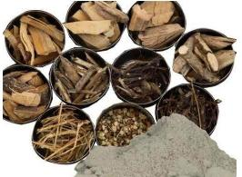
What is Dashmool ?
निरुक्ति :-
दशसंख्यकानां मूलानां समाहारः पात्रा० न वा ङीत् ।
An ayurvedic formulation, literally means `ten roots’
Made by combining dried roots of ten specific medicinal plant .
Spelled as Dasamoola ,Dashmoola and Dashmula.
Use in various dosage forms i.e churna,kwatha/kashaya,taila,ghrit,awaleha,kashirapaka and arishtha .
It is important ingredient of many highly popular formulations like chyavanaprasa ,etc..
(चक्रदत्त)

Slide 3
Reference in ayurvedic text :
चरक संहिता - सूत्रस्थान अध्याय ( षड्विरेचनशताश्रितीयाध्यायः ) 4/38 शोथहर महाकषाय
सुश्रुत संहिता- सूत्रस्थान अध्याय 38/67-72 ( द्रव्यसंग्रहणीय )
भावप्रकाशनिघण्टुः- गुडूच्यादिवर्गः 49

Slide 4
Dashomool composition
बृहद पंचमूल :-
बिल्वश्योनाकगंभारी पाटलागणिकारिकाः ।
दीपनं कफवातघ्नं पञ्चमूलमिदं महत् ||
(चक्रदत्त)
Comman name
Latin name
Family
Part used
Bilva
Agnimantha
Gambhari
Shyonak
Patala
Aegle marmelos
Premna integrifolia
Gmelina arborea
Oroxylum indicum
Stereospermum suaveolens
Rutaceae
Verbenaceae
Verbenaceae
Bignoniaceae
Bignoniaceae
Mool,twak
Mool,twak
Mool
Mool
Mool,twak

Slide 5
लघु पंचमूल :-
शालपर्णीपृश्निपर्णीवृहतीद्वयगोक्षुरम् । वातपितहरं वृष्यं कनीयः पञ्चमूलकम् ||
(चक्रदत्त)
Common name
Latin name
Family
Part used
Shalparni
Prishnaparni
Brihati
Kantakari
Gokshuru
Desmodium gangeticum
Uraria picta
Solanum indicum
Solanum xanthocarpum
Tribulus terrestris
Fabaceac
Fabaceac
Solanaceae
Solanaceae
Zygophyllaceae
Panchang
Mool
Mool,Fal
Panchang
Mool,Fal

Slide 6
बृहत्पञ्चमूल
श्रीफलः सर्वतोभद्रा पाटला गणिकारिका । श्योनाकः पञ्चभिश्चैतैः पञ्चमूलं महन्मतम् ॥29॥ पञ्चमूलं महत् तिक्तं कषायं कफवातनुत् । मधुरं श्वासकासघ्नमुष्णं लघ्वग्निदीपनम् ॥3०
(भा. प्र. गुडूच्यादिवर्ग 3)
लक्षण और गुण :-
बेल, गम्भारी, पाढल, अरनी और सोनापाठा इन पाँचों वृक्षों के मूल एकत्र करने से ‘बृहत् पञ्चमूल’ होता है |
गुण - तिक्त, कषाय तथा मधुर रसयुक्त, कफवात- नाशक एवं श्वास तथा कास को दूर करने वाला, उष्णवीर्य, लघु और अग्निदीपक होता है।

Slide 7
बिल्व:-
बिल्वः शाण्डिल्यशैलूषौ मालूरश्रीफलावपि । श्रीफलस्तुवरस्तिक्तो ग्राही रूक्षोऽग्निपित्तकृत् ।। वातश्लेष्महरो बल्यो लघुरुष्णश्च पाचनः ॥१३॥
(भा. प्र. गुडूच्यादिवर्ग 3)
बेल के नाम तथा गुण- बिल्व, शाण्डिल्य, शैलूष, मालूर और श्रीफल ये सब संस्कृत नाम बेल के हैं। बेल-कषाय तथा तिक्त रस युक्त, ग्राही, रूक्ष, अग्निवर्धक, पित्तकारक, वात कफनाशक, बलकारक, लघु, उष्णवीर्य तथा पाचक है।

Slide 8
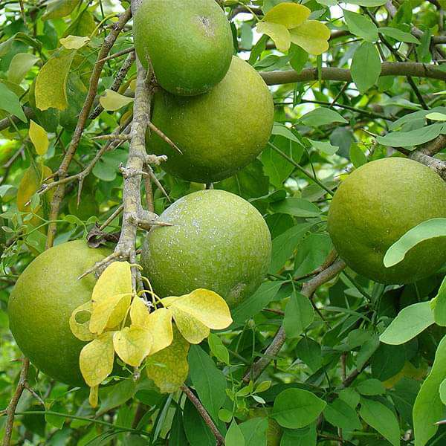
बिल्व:-
Botanical name:-Aegle marmelos
Family -Rutaceae
रस :- कषाय, तिक्त
गुण:- लघु , रूक्ष
वीर्य:- उष्ण
विपाक:- कटु
Chemical composition :-
Alkaloids: aeglin, aegelenine, dictamine, fragrine
Coumarins: marmelosin, marmesin, imperatorin.
Polysaccharides: galactose, arabinose , uronic acid.

Slide 9
Doshakarma: Vata kaphahara
Dhatukarma: Balya
Malakarma: Grahi
Therapeutic Uses:-
1. Inflammation: A hot poultice of the leaves is applied in ophthalmia or severe inflammation of conjunctiva with acute bronchitis and inflammation of other body parts .
2. Rheumatic pain: Leaf paste of A. marmelos is applied for rheumatic pain.
3.Bone fracture: Paste of leaves are mixed with butter applied over fractured area, and bound in bone fracture.

Slide 10
Arsha (hemorrhoids): Powder of equal parts of fruit pulp of Bilva, Shunthi, Ajwain, and Citraka root is given in a dose of 3 g with Takra (butter milk) twice a day in nonbleeding piles. After massaging the affected area, it is advised to sit in the warm decoction of Bilva or butter milk .
Nausea and vomiting: Cold decoction of Bilva or Guduchi added with honey , rice water should be taken in vomiting.
Jaundice: Intake of Bilva leave juice mixed with Trikatu alleviates jaundice .
Udar roga (abdominal disease): Oil mixed with alkali of Bilva should be given in pain of sides caused due to vata, stiffness, and cardiac distress .
Grahani roga : Paste of tender fruit of Bilva mixed with Shunthi powder and jaggery keeping the patient on the diet of butter milk alleviates severe grahani roga .
Edema: Juice of Bilva leaves mixed with maricha useful in edema caused by the following three doshas constipation, piles, and jaundice .
Jwara (fever): Milk cooked with Erand root or tender fruit of Bilva gives relief from fever.

Slide 11
अग्निमन्थो जयः सस्याच्छ्रीपर्णी गणिकारिका । जया जयन्ती तर्कारी नादेयी वैजयन्तिका ॥23॥ अग्निमन्थः श्वयथुनुद्वीर्योष्णः कफवातहृत् । पाण्डुनुत्कटुकस्तिक्तस्तुवरो मधुरोऽग्निदः ॥24॥
अग्निमंथ:-
(भा. प्र. गुडूच्यादिवर्ग 3)
अगेथू या अरनी के नाम तथा गुण - अग्निमन्थ, जय, श्रीपर्णी, गणिकारिका, जया, जयन्ती, तर्कारी, नादेयी और वैजयन्तिका ये सब संस्कृत नाम 'अगेथू' या 'अरनी' के हैं। अरनी शोथनाशक, उष्णवीर्य, कफवात तथा पाण्डुरोग को दूर करने वाला, कटु, तिक्त, कषाय तथा मधुर रस युक्त एवं अग्निवर्धक है।

Slide 12
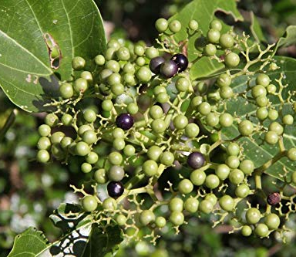
अग्निमंथ:-
Latin name- Premna integrifolia
Family – Verbenaceae
रस- तिक्त, कटु, कषाय
गुण -रुक्ष ,लघु
वीर्य - उष्ण
विपाक - कटु
Chemical composition :-
roots and bark have premnine, betulin, ganiarine, ganikarine, caryophyllene, premnenol etc.

Slide 13
Doshakarma: Kapha vatahara
Dhatukarma: Medohara
Malakarma: Saraka
Therapeutic use :-
1.Granthi visarpa : Paste of Vanshpatra and Agnimanth is applied locally to the affected area .
2. Arsha (piles): Avagahan sweda (Sitz bath) with leaf decoction of Agnimanth, Shigru, and Ashmantaka reduces inflammation and pain in arsha .
3. Urusthambha (stiffness of thigh): Regular application of Agnimanth root powder mixed with cow's urine or fermentation with the decoction of Agnimantha and Karanj leaves reduces inflammation in Urusthambha .

Slide 14
श्योनाकः शोषणश्च स्यान्नटकट्वङ्गटुण्टुकाः । मण्डूकपर्णपत्रोर्णशुकनासकुटन्नटाः ॥25॥
दीर्घवृन्तोऽरलुश्चापि पृथुशिम्बः कटम्भरः । प्रयोनाको दीपनः पाके कटुकस्तुवरो हिमः । ग्राही तिक्तोऽनिलश्लेष्मपित्तकासप्रणाशनः 26
श्योनाक :-
(भा. प्र. गुडूच्यादिवर्ग 3)
सोनापाठा या अरलू के नाम तथा गुण- श्योनाक, शोषण, नट, कट्वङ्ग, टुण्टुक, मण्डूकपर्ण, पत्रोर्ण, शुकनास, कुटन्नट, दीर्घवृन्त, अरलु, पृथुशिम्ब और कटम्भर ये सब संस्कृत नाम 'सोनापाठा' के है। सोनापाठा-अग्निदीपक, पाक में कटुरस तथा स्वाद में कषाय और तिक्तरस से युक्त, शीतवीर्य और मलसंग्राहक है। यह वात, कफ, पित्त तथा कास का विनाशक है।

Slide 15
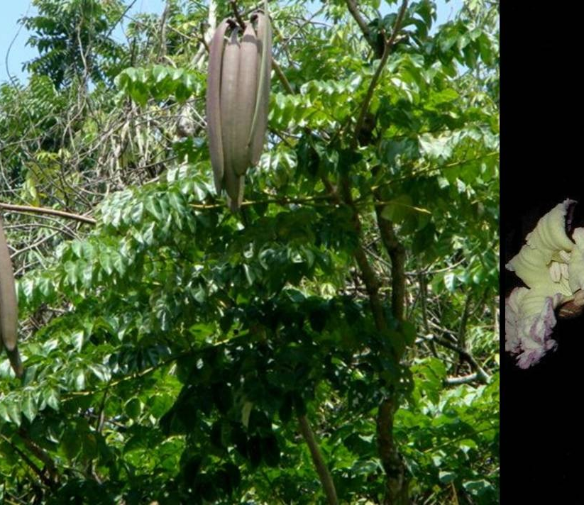
श्योनाक :-
Latin name - Oroxylum indicum
Family –Bignoniaceae
रस- मधुर, तिक्त, कषाय
गुण -लघु, रूक्ष
वीर्य - उष्ण
विपाक- कटु
Chemical composition :-
Leaf: Chrysin, oroxylin-A, scutellarin, baicalein , apigenin.
Root bark: Chrysin, baicalein biochanin-A.

Slide 16
Doshakarma: Vata kaphahara
Dhatukarma: Rakta stambhak
Malakarma: Stambhana
Therapeutic use :-
1.Atisaar (diarrhea): The juice of Shyonaka obtained by putaka process is used to treat diarrhea .
2. Udar roga (abdominal diseases): Oil processed with alkali of Agnimanth, Shyonaka, Palasa, Vata, Kadali, and Apamarga should be given to alleviate all types of udara roga .

Slide 17
3. Uru sthamba (stiffness thigh): Shyonakadi yoga is used in uru sthamba .
4. Karna roga (diseases of ear): Shyonaka taila is useful.
5. Vata vyadhi (neuromuscular diseases): It enters into the formulation of mulaka- taila .
6. Cyst: Shyonaka is the main content of Him sradi yoga.
7. Bhuta upasarga (viral infections): Pellets made of Karanja. Trikatu, roots of Shyonaka, Eranda, Bilva, and two types of Haridra are used as collyrium.

Slide 18
पाटला:-
पाटलि पाटलाऽमोघा मधुदूती फलेरुहा। कृष्णवृन्ता कुबेराक्षी' कालस्थाल्यलिवत्लपा ताम्रपुष्पी च कथिता ॥ 19
(भा. प्र. गुडूच्यादिवर्ग 3)
पाढल के नाम और गुण- पाटलि, पाटला, अमोधा, मधुदूती, फतेह कृष्णवृन्ता, कुबेराक्षी, कालस्थाली, अलिवल्लभा और ताम्रपुष्पी ये सब संस्कृत नाम 'पाढल' के हैं।
पाटला तुवरा तिक्ताऽनुष्णा दोषत्रयापहा। अरुचिश्वासशोथास्त्रच्छर्दिहिक्कातृषाहरी ॥21
पाढल-कषाय तथा तिक्तरस युक्त एवं अनुष्णवीर्य है। यह त्रिदोष, अरुचि, सोथ रक्तप्रकोप, वमन, हिचकी और तृषा को दूर करने वाली है।
(भा. प्र. गुडूच्यादिवर्ग 3)

Slide 19
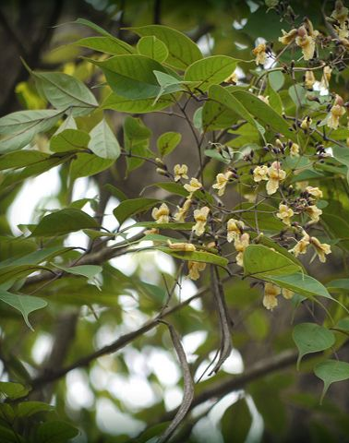
पाटला:-
Latin name - Stereospermum suaveolens
Family -Bignoniaceae
रस - तिक्त, कषाय
गुण - लघु, रूक्ष
वीर्य - उष्ण
विपाक - कटु
Chemical composition :-
plant is rich in flavonoids, saponins, phenolic com- pounds, and tannins. Bark has sterekunthal A & B, lapachol , dehydro-x-lapachone, sterochenol A & B, apigenin (flavonoid). Roots are rich in acetyl alcohol, oleic, palmitic, stearic acid .

Slide 20
Doshakarma: Tridoshahara
Dhatukarma: Shothahara, hridya, balya
Malakarma: Mutral, vata anulomana
Therapeutic use :-
1. Vranabandhana (for wrapping wounds): Tender leaves of Kadamb, Arjuna, Nimba, Patala, Ashwathva, and Arka are used to cover wounds .
2. Adhkapari (hemicrania): Patala beeja kalka is applied on forehead and temporal region in hemicranias.

Slide 21
3. Dagdh vrana (burn): Katu taila processed with decoction and paste of Patala on external application gives relief in pain and discharge in dagdh vrana, reduces burning sensation and blister formation .
4. Hikka (hic-cough): Flowers and fruit juice are taken with honey to control hiccups .
5. Ashmari and Mutraghata (calculus and retention of urine): Seven times decanted Kshara of Patala mixed with oil is used in mutravikara .
6. Ashmari (urinary calculus): Kshara of Patala and Karavira should be taken in ashmari .

Slide 22
गम्भारी :-
गम्भारी भद्रपर्णी च श्रीपर्णी मधुपर्णिका ।
काश्मीरी काश्मरी हीरा काश्मर्यः पीतरोहिणी। १४॥
कृष्णवृन्ता मधुरसा महाकुसुमिकाऽपि च ।
काश्मरी तुवरा तिक्ता वीर्योष्णा मधुरा गुरुः ॥१५॥
दीपनी पाचनी मेध्या भेदिनी भ्रमशोषजित् । दोषतृष्णाऽऽमशूलार्शोविषदाहज्वरापहा ॥१६॥
गम्भारी के नाम तथा गुण - गम्भारी, भद्रपर्णी, श्रीपर्णी, मधुपर्णिका, काश्मीरी, काश्मरी, होगा काश्मर्य, पीतरोहिणी, कृष्णवृन्ता, मधुरसा और महाकुसुमिका ये सब संस्कृत नाम गम्भारी के हैं। गम्भारी- मधुर, कषाय तथा तिक्त रस युक्त, उष्णवीर्य, गुरु, अग्निदीपक, पाचक, मेधा के लिये हितकर तथ मलभेदक होती है। यह भ्रम, शोष, वातादिक दोष, तृषा, आम, शूल, बवासीर, विष, दाह और ज्वर इन सभी रोगों को दूर करने वाली होती है।
(भा. प्र. गुडूच्यादिवर्ग 3)

Slide 23
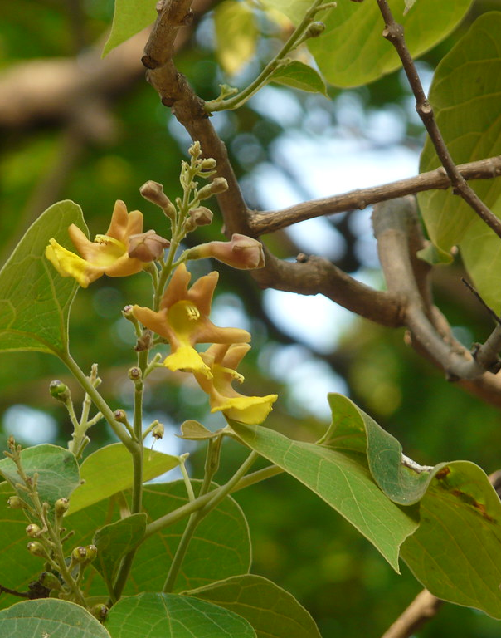
गम्भारी :-
Latin name - Gmelina arborea
Family – Verbenaceae
रस - तिक्त ,कषाय, मधुर
गुण -गुरु
वीर्य - उष्ण
विपाक - कटु
Chemical composition :-
The plant is rich in gmelofuran, alpha and beta sitosterol, ceryl alcohol.
This Photo by Unknown author is licensed under CC BY-SA.

Slide 24
Doshakarma: Tridosha shamaka
Dhatukarma: Balya, rasayana, vrishya
Malakarma: Mrudu virechaka, mutral
Therapeutic use :-
1.Pilatya: Taila prepared with Gambhari is taken as nasya to control graying of hairs.
2. Vata rakta: Application of Gambhari and Madhuka paste or Siddh taila is beneficial in vata rakta .
3. Raktapitta (bleeding disorders): Pakwa fruits of Udumbar, Kashmarya, Haritaki, Kharjura, and Draksha each taken separately with madhu control hemorrhage Flowers of Kovidara, Kashmarya, and Shalmali taken as vegetable daily is useful in raktapitta .
4. Jwar (fever): Cold decoction of Kashmarya mixed with sharkara pacifies trishna and daha in pittaj jwar .

Slide 25
लघुपंचमूलम्:-
शालपर्णी पृश्निपर्णी वार्त्ताकी कण्टकारिका ।
गोक्षुरः पञ्चभिश्चैतैः कनिष्ठं पञ्चमूलकम् ॥47॥
पञ्चमूलं लघु स्वादु बल्यं पित्तानिलापहम् । नात्युष्णं बृंहणं ग्राहि ज्वरश्वासाश्परीप्रणुत् ॥48॥
( भा. प्र. गुडूच्यादिवर्ग 3 )
लघु पञ्चमूल के लक्षण तथा गुण -
सरिवन, पिठवन, बड़ी कटेरी, भटकटैया और गोखरू इन पाँचों के मूल एकत्र करने से लघु पञ्चमूल कहलाता है। लघुपञ्चमूल - लघु, स्वादु, बलकारक, वातपित्तनाशक, बृंहण, ग्राही एवं ज्वर, श्वास और पथरी को दूर करने वाला होता है तथा यह अत्यन्त उष्णवीर्य नहीं होता है |

Slide 26
शालपर्णी :-
शालपर्णी स्थिरा सौम्या त्रिपर्णी पीवरी गुहा । विदारिगन्धा दीर्घाङ्गी' दीर्घपत्रांऽशुमत्यपि ॥३१॥
शोषदोषत्रयहरी बृंहण्युक्ता रसायनी ।तिक्ता विषहरी स्वादुः क्षतकासकृमिप्रणुत् ॥३३॥
शालपर्णी गुरुश्छर्दिज्वरश्वासातिसारजित् ॥३२॥
(भा. प्र. गुडूच्यादिवर्ग 3)
सरिवन' के नाम तथा गुण - शालपर्णी, स्थिरा, सौम्या, त्रिपर्णी, पीवरी, गुहा, विदारिगन्धा,दीर्घाङ्गी, दीर्घपत्रा तथा अंशुमती ये सब संस्कृत नाम 'सरिवन' के हैं। सरिवन-पाक में गुरु और वमन, ज्वर, श्वास, अतिसार, शोष तथा त्रिदोष का नाशक है एवं वृंहण, रसायन, तिक्त तथा मधुर रसयुक्त और विष, क्षयकास तथा कृमि का भी नाशक है।

Slide 27
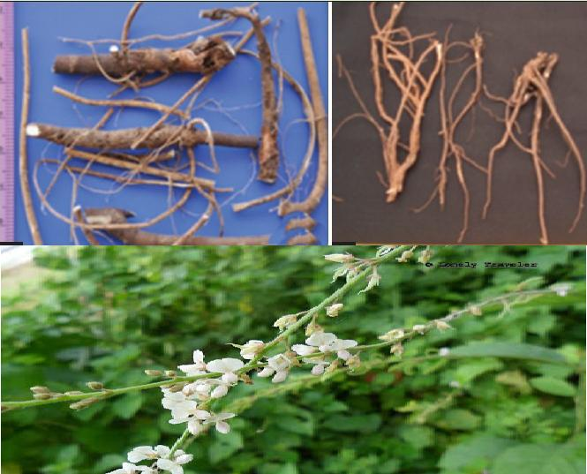
शालपर्णी :-
Latin name -Desmodium gangeticum
Family – Fabaceae
रस- मधुर, तिक्त
गुण- गुरु, स्निग्ध
वीर्य- उष्ण
विपाक - मधुर
Chemical composition :-
Rich in flavonoids, alkaloids, pterocarpans, phytosterol, phenylpropanoids,
Voltile oil .

Slide 28
Doshakarma: Tridoshahara
Dhatukarma: Balya, Vrishya
Malakarma: Mutral
Therapeutic use:-
1.Ardita vata (hemicrania): Juice of Shalaparni should be applied locally or snuffed to alleviate hemicranias .
2. Sukha Prasava Dharana (for easy delivery): Application of the Shalaparni root paste on navel, pelvis, vulva, etc. expels the confounded foetus .

Slide 29
3. Diseases of eye: Shalaparni root combined with rock salt and marich and rubbed with sour gruel in a copper vessel should be used as collyrium; it destroys pila .
4. Hrit-shoola (cardiac pain): Shalaparni boiled with milk is efficacious in cardiac pain .
5. Rakta pitta (hemorrhage): Shalaparni with mudga rasa in ahara .
6. Vatarakta (gout): Shalaparni, Prisniparni, and both types of Brihati are pounded with milk and mixed with tarpana and applied externally in gout .

Slide 30
पृश्निपर्णी :-
पृश्निपर्णी पृथक्पर्णी चित्रपण्र्ण्यहिपण्र्ण्यपि । क्रोष्ठविन्ना सिंहपुच्छी कलशी धावनिर्गुहा ॥३४॥
पृश्निपर्णी त्रिदोषघ्नी वृष्योष्णा मधुराऽसरा । हन्ति दाहज्वरश्वासरक्तातीसारतृड्वमीः ॥३५॥
(भा. प्र. गुडूच्यादिवर्ग 3)
पिठवन के नाम तथा गुण- पृश्निपर्णी, पृथक्पर्णी, चित्रपर्णी, अहिपर्णी, क्रोष्टुविन्ना, सिहपुच्छी, कलशी, धावनी और गुहा ये सब संस्कृत नाम पिठवन के हैं। पिठवन- त्रिदोष को दूर करने वाली, वृष्य, उष्णवीर्य, मधुर रस युक्त तथा संग्राही होती है। यह दाह, ज्वर, श्वास, रक्तातिसार, तृषा और वमन को दूर करती है।

Slide 31
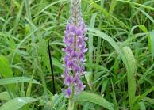
पृश्निपर्णी :-
Latin name - Uraria picta
Family - Fabaceae
रस- मधुर, तिक्त
गुण - लघु, स्निग्ध
वीर्य - उष्ण
विपाक -मधुर
Chemical composition :-
Prishniparni roots are reported to be rich in flavonoids, isoflavanones, tri terpenes, steroids, stigmasta-4 .

Slide 32
Doshakarma: Tridoshashamaka
Dhatukarma: Vrishya, balya
Malakarma: Sara, mutral
Therapeutic use :-
1.Sarpa Dansha (snake bite): Fresh juice extracted from Prishniparni panchang is applied on the affected area in snake poison, scorpion sting, and other insect bite.
2. Vrana Ropana (wound healing): Ghrita prepared with Prishniparni, Kapikacchu, Haridra, Malati, sharkara, and drugs of Kakolyadi gana should be used for vranaropana .
3.Rakta-atisaar (bleeding diarrhea): Peya (liquid gruel) prepared with Prishniparni checks bleeding in diarrhea .
4.Rakta-arsha (bleeding piles): Lajapeya processed with Bala and Prishniparni controls bleeding in arsha .

Slide 33
5. Raktapitta (hemorrhagic disorders): Yavagu prepared with Masura and Prishniparni added with madhu sharkara checks internal hemorrhage .
6. Bhagna (fracture): Intake of Prishniparni mool churna with mansh rasa for 3 weeks unites the fracture bone .
7. Vatarakta (gout): Prishniparni cooked in Aja dugdha and mixed with madhu sharkara is beneficial in vatarakta .
8. Madatyaya janya trishna (thirst due to alcoholism): Water processed with Prishniparni should be used as drink in excessive thirst due to alcoholism .

Slide 34
बृहती :-
वार्त्ताकी क्षुद्रभण्टाकी महती बृहती कुली। हिङ्गुली राष्ट्रिका सिंही महोष्टी दुष्प्रघर्षिणी ॥३६॥
कटुतिक्ताऽऽस्यवैरस्यमलारोचकनाशिनी । उष्णाकुष्ठज्वरश्वासशूलकासाग्निमान्ध्रजित् ॥३७॥
(भा. प्र. गुडूच्यादिवर्ग 3)
बड़ी कटेरी के नाम तथा गुण - वार्ताकी, क्षुद्रभण्टाकी, महती, बृहती, कुली, हिङ्गुली, राष्ट्रिका, सिही, महोष्ट्री और दुष्प्रघर्षिणी ये सब संस्कृत नाम बड़ी कटेरी के हैं। बड़ी कटेरी-संग्राही (मलरोधक), हृदय को हितकर, पाचक, कफवात-नाशक, कटु तथा तिक्तरस-युक्त होती है। यह मुख की विरसता ,मल और अरुचि का नाश करने वाली, उष्णवीर्य तथा कुष्ठ, ज्वर, श्वास, शूल, कास और अग्नि मन्दता इन सभी रोगों को दूर करने वाली होती है।

Slide 35
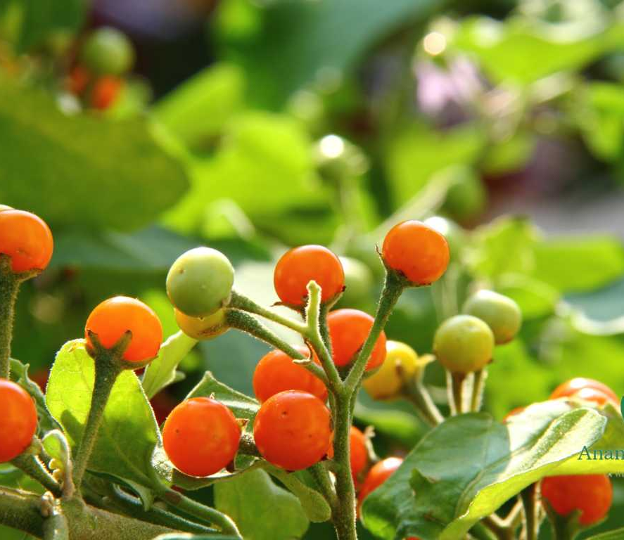
बृहती :-
Latin name -Solanum indicum
Family –Solanaceae
रस- कटु, तिक्त
गुण- लघु, रूक्ष, तीक्ष्ण
वीर्य- उष्ण
विपाक-कटु
Chemical composition :-
Phytoconstituents like phytosterols, steroidal glycosides, steroidal glycoalkaloids, flavonoids, and fatty acid .

Slide 36
Doshakarma: Vata kapha shamaka
Dhatukarma: Sukra rechaka, Ruksha
Malakarma: Grahi, mutrala
Therapeutic use :-
1.Khalitya (alopecia): The fruit juice of Brihati mixed with honey and applied locally to inhibit alopecia .
2. Khalitya (alopecia): Fruit and root of gunja are pounded with the juice of brihati fruits and rubbed with Datura fruit. It stops alopecia .
3. Aruchi (anorexia): Brihati fruits are cooked and mixed with spices and the consumed with curd to increase appetite .
4. Jwar (fever): Powder of Brihati fruit, Pippali, and shunthi prevent sneezing and regain consciousness in fever .
5. Grahani roga : Brihati fruit powder with buttermilk is taken daily to treat indigestion and grahani .

Slide 37
कण्टकारी :-
कण्टकारी सरा तिक्ता कटुका दीपनी लघुः ॥४०॥
रूक्षोष्णा पाचनी कासश्वासज्वरकफानिलान् । निहन्ति पीनसं पार्श्वपीडाकृमिहृदामयान् ॥४१॥
(भा. प्र. गुडूच्यादिवर्ग 3)
भटकटैया के गुण-भटकटैया - दस्तावर, तिक्त तथा कटुरसयुक्त, अग्निदीपक, लघु, रूक्ष, उष्णवीर्य और पाचक होती है। यह खाँसी, श्वास, ज्वर, कफ, वात, पीनस, पार्श्वपीड़ा (पसली का दर्द), कृमि तथा हृद्रोग इन सभी रोगों को दूर करती है

Slide 38
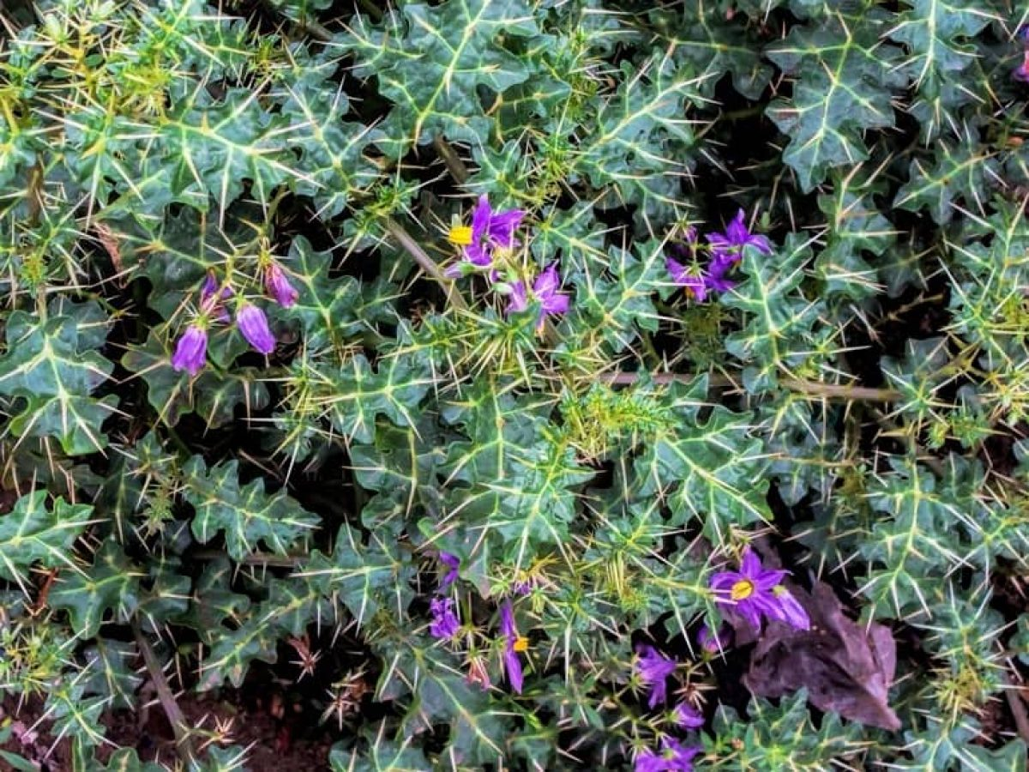
कण्टकारी :-
Latin name - Solanum xanthocarpum
Family -Solanaceae
रस- तिक्त, कटु
गुण --लघु, रूक्ष, तीक्ष्ण
वीर्य - उष्ण
विपाक- कटु
Chemical composition :-
Contains alkaloids, sterols, saponins, flavonoids, and their glycosides. In addition to this carbohydrates, fatty acids, amino acids etc are also present.

Slide 39
Doshakarma: Kapha vatashamak
Dhatukarma: Sukra-rechan
Malakarma: Rechana, mootrala
Therapeutic use :-
1.Yuvan pidika (acne): The fruit paste is applied externally to the affected area for treating pimples and swellings .
2. Kasa (cough): Kantakari is the best medicine for kasa The juice prepared from the whole plant of Kantakari by putapak vidhi is given with Pippali powder to treat kasa, shwasa, and kaphaja vyadhi .
3. Shwasa (asthma): The mixture of 6 g of Kantakari and 3 g of Hingu is licked with honey to cure shwasa within 3 days .
4.Apasmara (epilepsy): The fruit juice of Kantakari is given as nasya to cure the attack of epilepsy and restore the consciousness quickly .
5. Mutra ghata (retention of urine): Juice of Kantakari is given with honey to get relief from mutra ghata .
6. Chronic cough in children: Avaleha (linctus) prepared from flower of Kantakari is given to get relief from chronic cough in children .

Slide 40
गोक्षुर :-​
​
​
गोक्षुरः क्षुरकोऽपि स्यात्त्रिकण्टः स्वादुकण्टकः । गोकण्टको गोक्षुरको वनश्रृङ्गाट इत्यपि ॥४४॥
पलङ्कषा श्वदंष्ट्रा च तथा स्यादिक्षुगन्धिका । गोक्षुरः शीतलः स्वादुर्बलकृद्वस्तिशोधनः ॥४५॥
मधुरो दीपनो वृष्यः पुष्टिदश्चाश्मरीहरः । प्रमेहश्वासकासार्शः कृच्छ्रहृद्रोगवातनुत् ॥४६॥
(भा. प्र. गुडूच्यादिवर्ग 3)
गोखरू के नाम तथा गुण - गोक्षुर, क्षुरक, त्रिकण्ट, स्वादुकण्टक, गोकण्टक, गोक्षुरक, वनश्रृङ्गाट, पलङ्कषा, श्वदंष्ट्रा तथा इक्षुगन्धिका ये सब संस्कृत नाम गोखरू के हैं। गोखरू-शीतवीर्य, स्वादु, बलकारक, बस्तिशोधक, मधुररसयुक्त, अग्निदीपक, वृष्य तथा पुष्टिकारक होता है। यह पथरी, प्रमेह, श्वास, खाँसी, बवासीर, मूत्रकृच्छ्र, हृद्रोग तथा वात को दूर करने वाला होता है।

Slide 41
Latin name – Tribulus terrestris
Family - Zygophyllaceae
रस - कषाय, तिक्त, कटु
गुण - लघु
वीर्य - शीत
विपाक-कटु
गोक्षुर :-
Chemical composition :-
plant is reported to have steroidal glycoside, steroidal saponin, flavonoids, alkaloids, lignanamides, and cinammic acid amides .

Slide 42
Doshakarma: Vata pitta shamaka
Dhatukarma: Rasayana, Balya, Vrishya
Malakarma: Mutral, Anulomana
Therapeutic use :-
1.Keshvardhan: Application of paste prepared with Gokshura and Tila pushpa mixed with madhu, ghrita in the root hairs promotes hair growth .
2. Ashmari (calculus): Roots of Gokshura, Kokilaksha, Eranda, and Brahati pounded together with dugdh and dissolved in madhur dahi help to dissolve calculus .
3. Mutra Kricchta (dysuria): Decoction of Gokshura seeds mixed with Yavakshara is given in dysuria, gravel, and calculus Decoction of Gokshura panchang mixed with madhu sarkara is administered in dysuria .
4. Rakta pitta : Intake of milk cooked with Shatavri, Gokshura, and four parni (ie.. shalaparni, prishanparni, mugdaparni, mashaparni) checks hematuria .

Slide 43
5. Shosha (consumption): Powder of Gokshura fruit and Ashwagandha mixed with madhu when taken with milk alleviates cough and consumption .
6. Aamvaat (arthritis): Regular use of decoction of Sunthi and Gokshura in the morning digests aam and reduces pain and inflammation in arthritis and backache .
7. Vaji karana (aphrodisiac): Powder of Gokshura, Shatavari, Kapikacchu, Nagbala, and Atibala taken with milk every night cures infertility and acts as a good aphrodisiac .

Slide 44
दशमूल:-
दशमूलं त्रिदोषघ्नं श्वासकासशिरोरुजः । तन्द्राशोथज्वरानाहपार्श्वपीडाऽरुचीहरत् ।। 49
( भा. प्र. गुडूच्यादिवर्ग 3 )
दशमूल के लक्षण तथा गुण - दशमूल-त्रिदोषनाशक तथा श्वास, खाँसी, सिर की पीड़ा, तन्द्रा, शोथ, ज्वर, आनाह, पार्श्वपीड़ा (पंसली का दर्द) एवं अरुचि को दूर करने वाला होता है।
आचार्य सुश्रुत के अनुसार दशमूल :-
गणः श्वासहरो होष कफपित्तानिलापहः । आमस्य पाचनश्चैव सर्वज्वरविनाशनः ।।72।।
(सु. सू. 35/ 72)
यह दशमूलगण चासनाशक, कफ, पित्त और वात का शामक, आमदोषों का पाचक तथा सर्वप्रकार के ज्वरों का नाशक है ।

Slide 45
बृहद पंचमूल :-
बिल्वाग्निमन्थटिण्टुकपाटलाः काश्मर्य्यश्चेति महत् ।। 69 ।।
(सु. सू. 35/ 69)
बिल्व, अरणी, सोनापाठा, पाढल और गम्भारी ये द्रव्य 'बृहत्पञ्चमूल' कहलाते हैं ।
लघु पंचमूल :-
त्रिकण्टकबृहतीद्वयपृथक्पण्यों विदारिगन्धा चेति कनीयः ।। 67।।
(सु. सू. 35/ 67)
इन पञ्चमूलों में गोखरू, छोटी कटेरी, बड़ी कटेरी, पृश्निपर्णी और विदारीगन्धा (शालपर्णी) यह लघु पञ्चमूल हैं ।

Slide 46
Clinical significance of Dashmool :-
Anti Inflammatory :-
Lysosomal membranes were ruptured during inflammation and the release of lytic enzymes further complicates the inflammatory process leading to inflammatory disorders.
Since RBC and lysosomal membrane are similar in structure, prevention of hemolysis is done by anti-inflammatory activity of Dashmool by stabilizing the RBC membrane.
Erythrocytes are attacked by the free radicals causing membrane disorganization and its lysis .
Flavonoids and phenols in Dashmool possess the ability to stabilize the membrane of mast cells which leads to prevention and lysis due to the anti inflammatory and membrane stabilizing potential contributed by the phenols, flavonoids, tannins, and vitamins present in Dashmool .

Slide 47
Inflammation
Rupture of lysosomal membrane (RBC and lysosomal membrane bears the same structure)
Stabilization of lysosomal and RBC membrane by Flavonoids and phenols present in the Dashmool.
Anti inflammation and prevention of hemolysis

Slide 48
Dashmool is a combination of 10 effective herbs mentioned in Ayurveda for their Anti-inflammatory properties. Dashmool kwath is beneficial for reducing / balancing Vata dosha especially in the Bones, Joints, muscles and Nerves. This makes it extremely useful in various painful, inflammatory and degenerative problems of joint like osteoarthritis, rheumatoid arthritis ,cervical spondylosis .
Cervical Spondylosis :-
Many medicinal preparations are commonly use for treatment of pain one such is Dashmool which is tridosha shamaka and specially Vata shamaka properties along with it is considered as Shothahara, which can be correlated as anti inflammatory, antioxidant or free radical scavenging property. Accordingly, it is indicated for the management of variety of disorders, which is caused by vitiation of Tridosha .
Reference By :-
Ashutosh Kumar Pathak, H.H Awasthi, Ajay Kr Pandey (Use of Dashamoola in cervical spondylosis: past and present perspective) "JOURNAL OF AYUSH AYURVEDA" Date 10-16-2015
Page no. 4

Slide 49
Analgesic and Anti Spasmodic :-
Muscle spasms and cramps can be sources of acute or chronic pain. By relaxing smooth muscles and reducing spasms, Dashmool may provide relief from muscular pain and discomfort.
Several constituents of Dashmool, such possess analgesic properties that can help alleviate pain by blocking pain signals or modulating neurotransmitter activity in the central nervous system. Additionally, these herbs may have nerve-calming effects, reducing the perception of pain and promoting relaxation.
Dashmool formulation along it's combination with aspirin shows comprable anti inflamatory, analgesic and anti platelet effect
Reference by :-
Reshma R Parekar, Somesh Padmaja and 2 others (Experimental evaluation of analgesic effect of dashmool )"GENERAL OF AYURVEDA AND INTEGRATIVE MEDICINE "
Date –1-11-2015

Slide 50
Anti Microbial:-
The presence of secondary metabolites like phenolic compounds, saponins, alkaloids, glycosides, flavonoids, terpenoid, phenolic tannins, flavonoids, terpenes etc.
Nitrogen compounds like alkaloids, amino acids etc .
The alkaloids, saponins, terpenoids, carbohydrates, and flavonoids in plant sources serve as potent antimicrobial agents .

Slide 51
Anti Bacterial :-
Bactericidal activity is either by damaging the bacterial membrane or by penetrating through the cell wall .
It Interferes with bacterial metabolism or forming complexes with enzymes/substrates or by chelating the ions essential for the survival of bacteria and inhibits the attachment of bacteria .
Tannins bind to the receptor of the cell and thus inhibit the binding of the viruses and also prevent the attachment of proteins essential for viral metabolism .
Tannins could effectively interact with hydroxyl radicals, quench free radicals, donate hydrogen atoms and form complexes with protein to scavenge the free radicals . Tannins were known to exhibit Anti Bacterial property .
Antibacterial activity is against two Gram-positive bacteria: B. subtilis, S. lutea and two Gram-negative bacteria: E.coli, Pseudomonas spp .

Slide 52
Dashmool
Anti viral
Interferes with bacterial metabolism ( By chelating the ions & inhibition to attachment of bacteria on cell )
Tannins present in dashmool binds to the receptor of cells.
Inhibits the binding of virus .
Also prevent attachment to protein of the virus .
Inhibits viral replication .

Slide 53
Anti oxidant :-
The antioxidant, properties manifested due to the secondary metabolites present in it.
The stem parts of Dashmool would serve as a potent source of antioxidants. the activity noted may be due to the appreciable amount of phenols, flavonoids, tannins and vitamin C .
Vitamin C is predominantly present in root extract followed by leaves and stem Ascorbic acid primarily present in plants acts as good reducing agent by donating hydrogen, breaking the radical chain, and reacts with peroxides .
The Phenolic compounds exhibit their antioxidant property by quenching the free radicals or chelate the metal ions or neutralize them by transferring the electrons or hydrogen.
Thus the presence of these secondary metabolites in Dashmool could act as antioxidants to scavenge any type of reactive oxygen species and prevent oxidative damage.

Slide 54
Vitamin C & Ascrobic acid is present in stem.
Act as a good reducing agent by donating H+ ion.
Neutralizes the reaction .
Secondary metabolite - Phenolic compound,Flavonoids are present.
Act as quenching the free radical or chelate metal ion .
Neutralizes the reaction .
Dashmool

Slide 55
Anti Diabetic :-
Chronic low-grade inflammation is associated with insulin resistance, a key factor in the development of type 2 diabetes,by reducing inflammation, dashmool may improve insulin sensitivity and glucose metabolism.
Oxidative stress plays a crucial role in the pathogenesis of diabetes by causing damage to pancreatic beta cells and impairing insulin signaling. Antioxidants help neutralize free radicals and protect pancreatic cells, thereby preserving their function and promoting insulin secretion.
They may enhance glucose uptake by peripheral tissues, stimulate insulin release from pancreatic beta cells, and inhibit gluconeogenesis (the production of glucose in the liver). These mechanisms collectively contribute to lowering blood sugar levels and improving glycemic control.

Slide 56
Nerve Protective Effects :-
Diabetes often leads to neuropathy, by nerve damage and pain.
Dashmool possess neuro protective properties that may help alleviate diabetic neuropathic pain and prevent further nerve damage.
Sedative and Anxiolytic Effect :-
Pain can often be accompanied by anxiety and sleep disturbances. Some constituents of Dashmool possess sedative and anxiolytic properties, promoting relaxation and improving sleep quality, which can indirectly alleviate pain and enhance overall well-being.

Slide 57
Renoprotective Effect :-
Diabetes is a leading cause of kidney disease (diabetic nephropathy). Some constituents of Dashmool, have been studied for their potential renoprotective effects, including reducing proteinuria (excess protein in the urine) and protecting against kidney damage.
Rgulation of Lipid Profile :-
Dashmool may help regulate lipid metabolism, promoting a healthier lipid profile and reducing the risk of cardiovascular complications associated with diabetes .
Diabetes is often accompanied by dyslipidemia, characterized by elevated levels of triglycerides and LDL cholesterol and decreased levels of HDL cholesterol .

Slide 58
Promote Digesition :-
Agnimand primarily arises due to an imbalance of the Pitta doshas in the body and portrays a state of an incomplete process of digestion.
Dashmool vigorously helps in treating a wide range of gastrointestinal abnormalities as well, like flatulence, peptic ulcer gastroesophageal reflux disease, constipation, heartburn, and stomach pain.
Dashmool additionally helps to eliminate abdominal gas and in turn curtails abdominal distension, bloating, and gaseous cramps.

Slide 59
Dashmool extensively assists in soaking up calcium in the bones and promotes bone mineral density.
This helps in strengthening the bones and connective tissue and prevents them from breaking in the advanced years.
It also plays a significant role in the generation of collagen in the bones, protecting the bones from damage and enhancing overall skeletal health.
Dashmool helps in curing osteoporosis and osteomalacia but also diminishes the risks of bone fractures in older age.
Strengthens Bone Health :-

Slide 60
Dashmool In Women Health :-
1. Menstrual Disorders: Dashmool can help regulate menstrual cycles by balancing hormonal levels and reducing inflammation in the reproductive organs. It may alleviate symptoms like irregular menstruation, excessive bleeding (menorrhagia), and painful menstruation (dysmenorrhea).
2. Fibroids: Fibroids are benign tumors that develop in the uterus. Dashmool's anti-inflammatory properties may help reduce the size of fibroids and alleviate associated symptoms such as heavy menstrual bleeding and pelvic pain.
3. Endometriosis: Endometriosis is a condition where the tissue that lines the uterus grows outside of it, causing pelvic pain and infertility. Dashmool's analgesic properties may help alleviate pain associated with endometriosis.

Slide 61
4. Pelvic Inflammatory Disease (PID): PID is an infection of the female reproductive organs, often caused by sexually transmitted bacteria. Dashmool's antimicrobial properties may help combat the infection, while its anti-inflammatory effects can reduce inflammation and pain in the pelvic region.
5. Uterine Prolapse: Uterine prolapse occurs when the uterus descends into the vaginal canal due to weakened pelvic floor muscles. Dashmool's rejuvenating properties may help strengthen the pelvic muscles and support the uterus, potentially reducing the severity of prolapse.
6. Infertility: In cases of infertility associated with uterine disorders, Dashmool may help improve reproductive health by balancing hormonal levels, reducing inflammation, and promoting overall uterine health.

Slide 62
Indications In Women Health :-
Dysmenorrhea(menstrual cramps)
Recurrent miscarriage
Pelvic inflammatory disease
Backache
Various uterine disorders
For prevention of uterine infections
Perineal pain
Inflammation of breasts
Postpartum complications
Postpartum fatigue
Postpartum depression
Partum appetite loss
Postpartum weakness
Anemia after pregnancy

Slide 63
Indications :-
Osteo arthritis
Constipation
Muscle spasm
Gas or flatulence
Low backache
Bloating
Rheumatoid arthritis
• Gout
• Facial paralysis
• General body aches
• Hemiplegia
• Fatigue with body aches
• Sciatica
• Cough & Bronchitis
Difficulty in Urination
Reduced flow of urine
Fibromyalgia
Asthma or Breathing troubles
Paralysis
Atherosclerosis

Slide 64
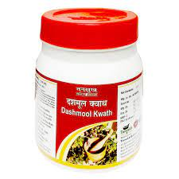
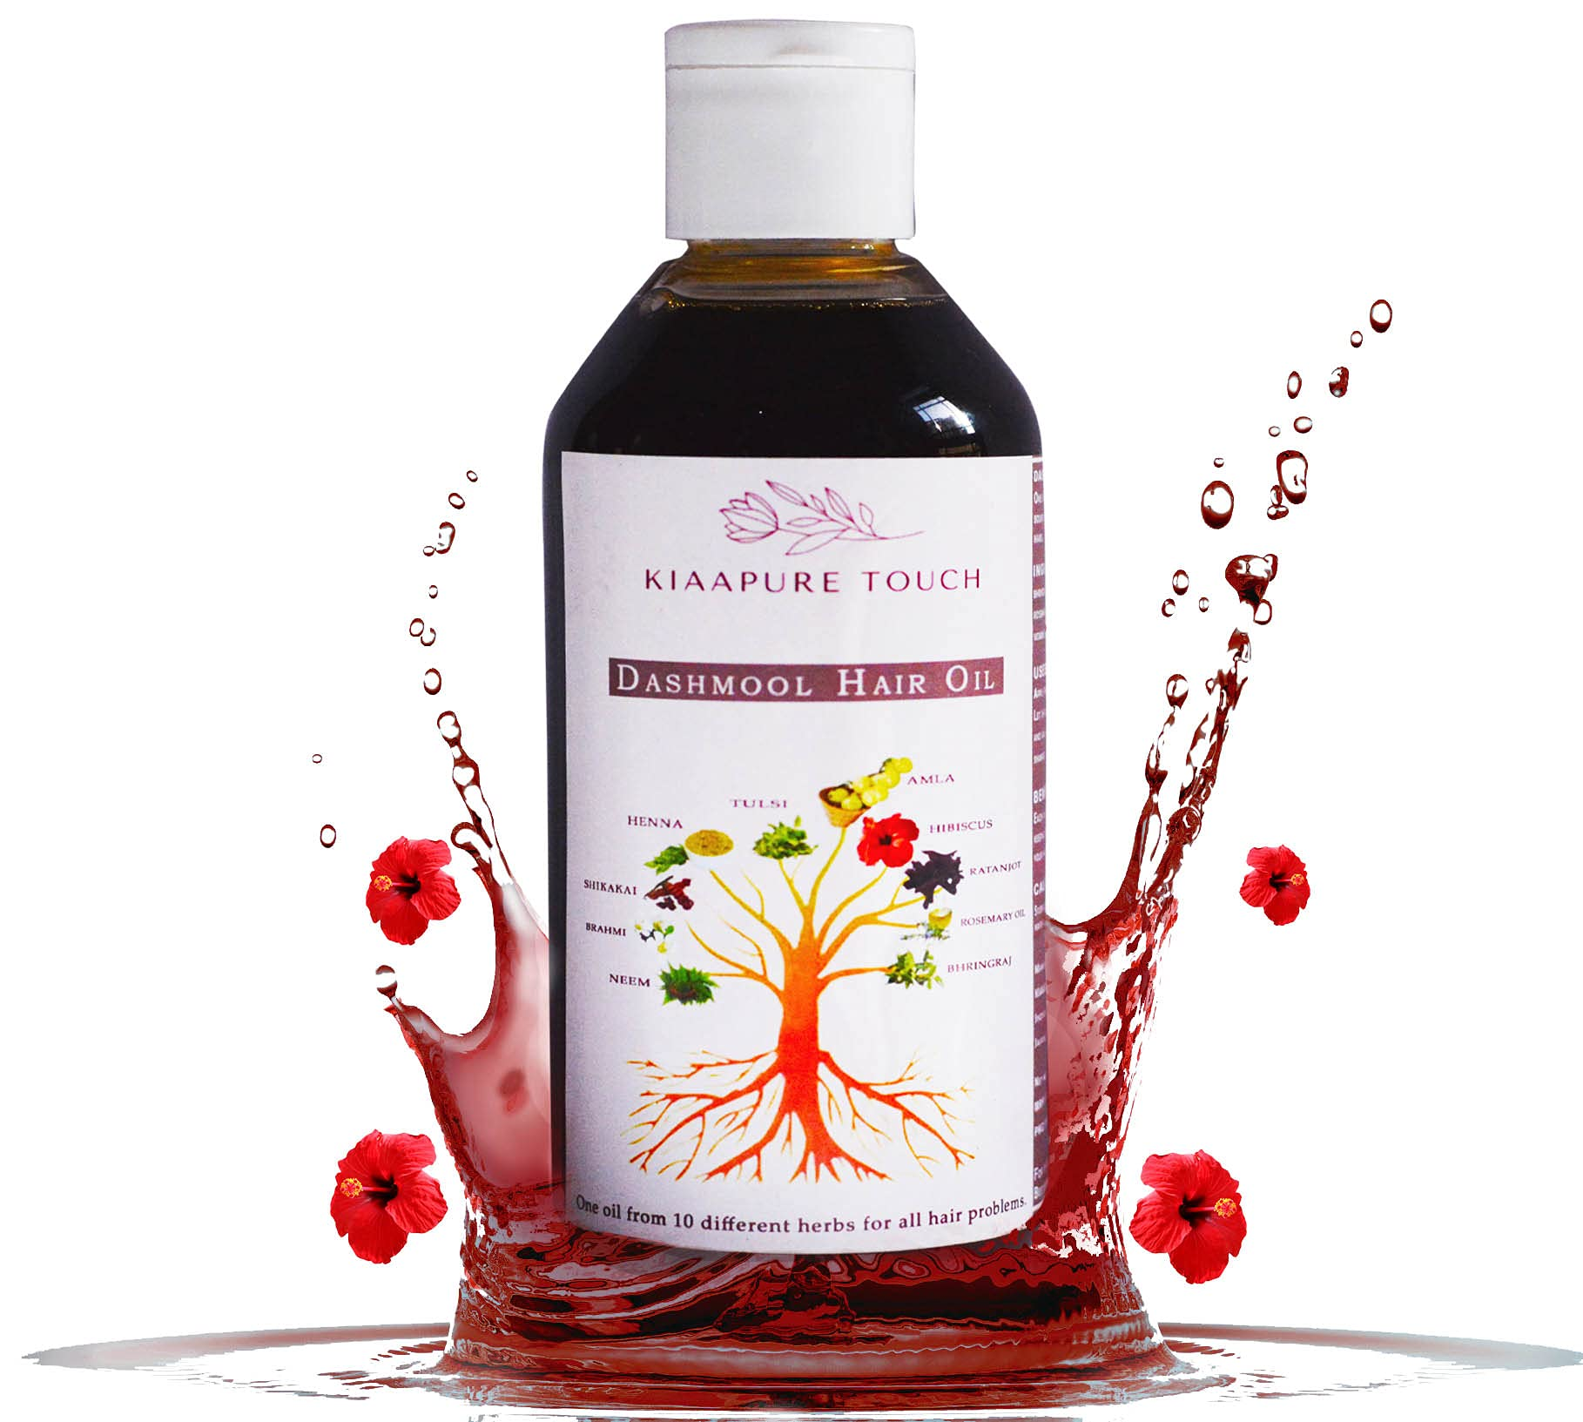
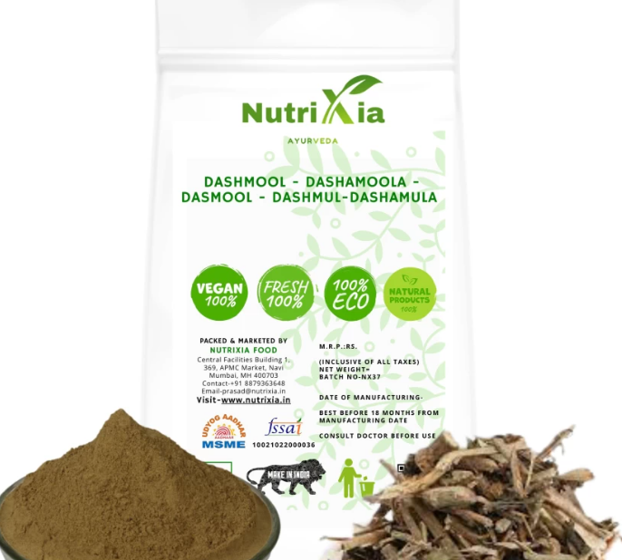
Market Preparation of Dashamoola:-
1. Dashmoola churn
2. Dashmoola kwatha churn
3. Dashmoola hair lep
4. Dashmoolarishta syrup
5. Dashmool ghanavati
6. Dasamoola jeerakarishtam
7. Dashamoola rasaayanam
8. Dashmool kwath

Slide 65
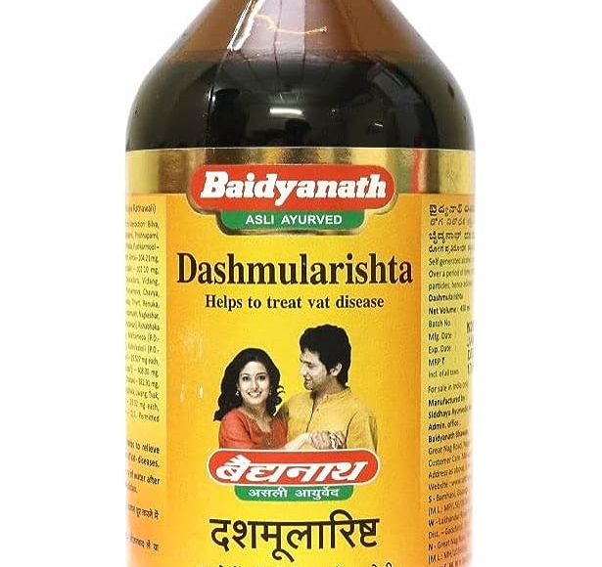
Dashmool kwath granules
• Dashamoolarishta
• Dashmoolakashayam
• Chyavanaprasha
• Dhanwantharam tailam
• Dashmoola Rasayana
• Dashamoola Haritaki

Slide 66
Contraindication
Allergies and Sensitivites
High dose in Pitta Prakriti Person
Note :- There is no absolute contraindication but should be used cautiously due to it's usna virya

Slide 67
पथ्ये सति गदार्तस्य किमौषधनिषेवणैः। पथ्येऽसति गदार्तस्य किमौषधनिषेवणैः ।।
(वैद्यजीवन 1/10)
जो व्यक्ति खान पान इत्यादि में - पथ्य का सेवन करता है उसे दवा लेने की आवश्यकता नहीं होती और जो पथ्य का सेवन न करे उसे औषधि से क्या लाभ ?

