Slide 1
JEEVAK AYURED MEDICAL COLLEGE AND HOSPITAL RESEARCH CENTER
SUDHA AND SHIKTA VARGA ,IT’S CLINICAL USE AND FORMULATION
Presented BY -
KAUSHAL RAI
SABIHA TANVEER
Batch – 2021-22
Guided by -
Dr .D. K. VERMA
( Reader and HOD )
Dr. sumit kumar
(lectUreR)

Slide 2
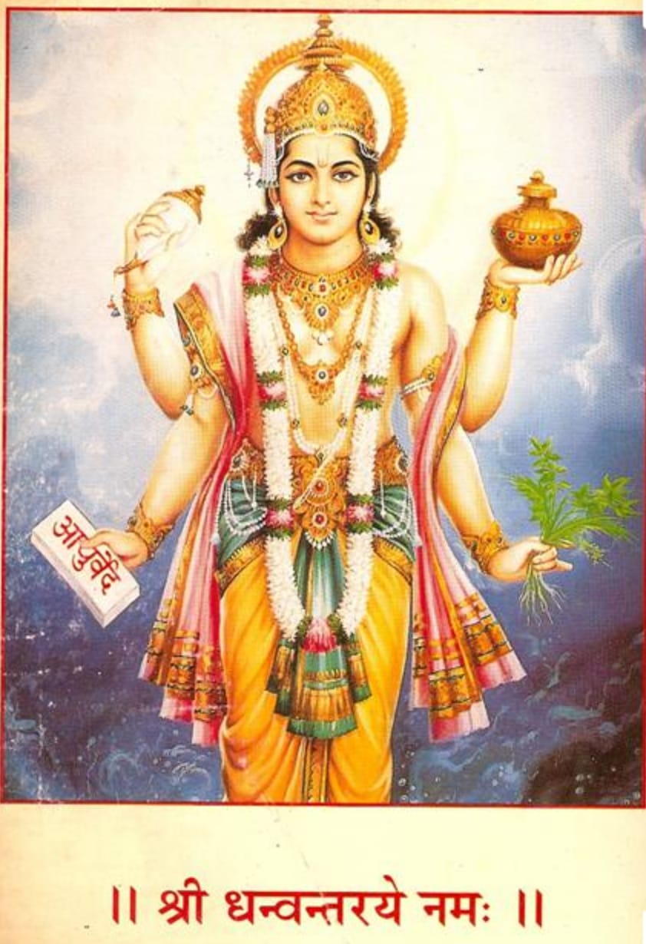

Slide 3
INTRODUCTION
The drugs which are available in Ayurvedic system of medicine are obtained either from herbal, animal and mineral sources.
There are many treatment modalities available in Ayurveda but Sudha vargiya Dravyas describe in Rasa-shastra literature plays an important role in the treatment of GIT disorders.

Slide 4
Bhasmas of Sudha vargiya Dravyas have attained importance in prevention and cure of conditions such as -
AmlaPitta (hyperacidity)
Grahani (IBS)
Annadrava shula (Gastric ulcer)
Parinaam shula (Duodenal ulcer)
Atisara (Diarrhea) etc
Bhasmas are considered as nano medicine in Ayurveda which is therapeutically very potent in small dose, quick acting and without specific taste

Slide 5
In the current kinetic era, Rasaushadhis have given Ayurveda a complete novel health care look.
All the drugs enlisted in Sudha Varga Dravya have calcium in compound form, as salts.
It plays very essential role in physiology and regulation of gastrointestinal secretions.
In Charak Samhita and Sushuruta Samhita Sudha comes under Parthiva Dravya.

Slide 6
Both Rasaratnakar and Rasarnava include it in Shukla Varga .
Rasamritam has included these drugs under Sudha Vijnaneyama based on their chemical composition.

Slide 7
Sikata varga is group of silicon-containing compounds drugs having alchemical as well as therapeutic value.
Classification of Sikata varga was not done in classical texts, the scattered references of these drugs and their usage in alchemy; various methods of binding of mercury (Parada bandhas) as well as internal .
Administration were enumerated. Authors of 20th century have grouped these drugs under a specified class called Sikata Varga.
Members of Sikata varga include Sikata, Dugdha Pashana, Kausheyashma, Nagapashana, Badarashma, Trinkanta, Akeeka .

Slide 8
Content of sudha varga
Traditional name
Common name
Sudha
Khatika
Godanti
Sawetanjan
Mrigshringa
Shukti
Shankha
Shambuka
Samudrafena
Kukkutandatwak
kurmapristha
Lime
Chalk
Gypsum
Safed surma /calacite
Hart’s horn /deer horn
Mothers of pearl
Conch shell
Pila
Cuttle fish bone
Egg shell
Tortoise bone

Slide 9
Content of shikta varga
Traditional name
Common name
Dhugdhapasan
Nagpashana
Kausheyasm
Badarashama
Talc
Serpentine
Asbestos
Rock fossil

Slide 10
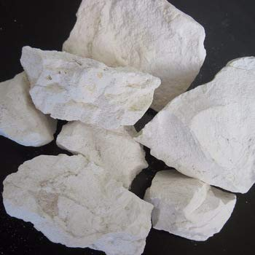
CHUNA (SUDHA)
Name –Lime – Calcium oxide
Group- Sudha varga
Synonyms -
Sudha, Churna, Churnaka, Saudhavilepana, Shilakshara .

Slide 11
Churnaodaka nirman
sudha 1 part and distilled water 240 parts dissolve in water and keep for 12 hours and filter through filter paper in vessel and get churnodaka.

Slide 12
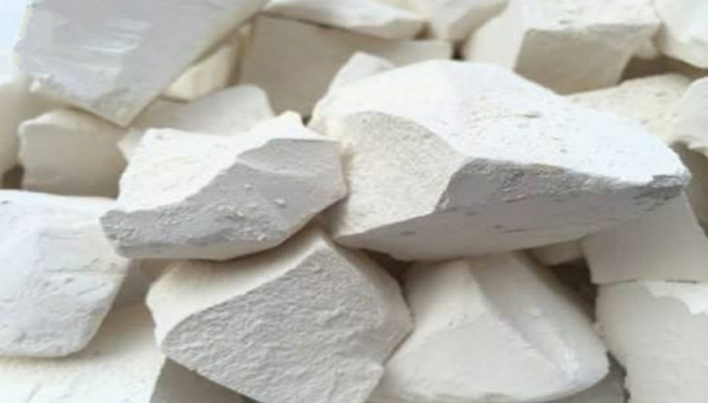
Khatika (chalk)
Name- khatika
Group -Sudha verga ,
English name –Pipe clay /Chalk

Slide 13
Synonyms -
Khatika , Khatini , Kapol , Shaweta , Lekhanmiritika Khati.
Discription- In Rasaratna samucchaya while describing the variety of Ghandhak is of four type and one of the variety is white in colour and is known as Khatika, useful in Lepana and Loha Maran
Properties - Khatika has madhura, Tikta Rasa , sheeta veerya,

Slide 14
SHODHAN(purification) OF KHATIKA
Method-Nirmalikaran / Prakshalan .
Materials Required - Khatika , Water
Apparatus Required- SS Vesels (stainless steel)
Refference-Rastarangini 11/210
Procedure-Fill the SS Vesels with pure water , dissolve the khatika in water , and allow to settle . Drain off supernatant clear water and desiccate the sediment to complete dryness.

Slide 15
Godanti
Name- Godanti
Latin Name – calcium sulphate dihydrate
Group–Sudha varga , Mineral sulphate .

Slide 16
Discription in Samhita - In sushuruta Samhita the godanti has been referred in two place
In sutra sthana in relation with cauterisation –Dahana materials and in the treatment of pittakapha vidagdhadristi as Anjan .
Synonyms -
Godantika, Godanta, Godant, Shweta etc.
Properties - Godanti bhasma rasa is kshariya (alkaline property), sheeta guna (cold property), sheeta virya

Slide 17
SODHAN OF GODANTI
Method - Swedan
Materials Required – Godanti , Acidic liquids or Bhringraj swaras
Apparatus Required- Dola yantra , heating device
Refference : Bhartiya Rasashastra
Procedure - Bundle the godanti in a piece of cloath in a suspended form in Dolayantra , fill half of its value with acidic liquid by means of rod, subject the apparatus to heating system for a period of three hours with constant monitoring . Replace the lost value , if any , with fresh liquid during the processing . Finally collect the materials and wash with hot water.

Slide 18
MARANA(processing) OF GODANTI
Materials required - Suddha godanti , kumari swaras /Nimbu patra swaras /Jayanti swaras.
Apparatus required - Sarav samputa /puta yantra , Khalva yantra.
Heating : Apply Gaja Puta
Procedure -Take the material in a mortar and pestle and levigate with the liquid media specified prepare pellets and allow to dry. Encapsulate the dried pellets and subject the capsule to Gajaputa heating system .Repeat the same process for another two cycles.

Slide 19
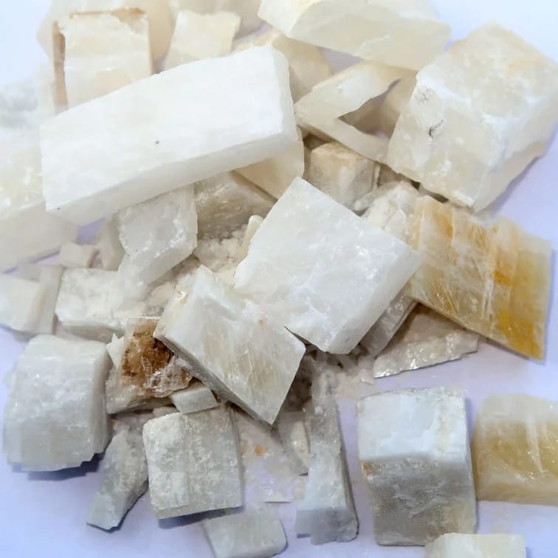
Shawetanjan (sapheada surma )
Name – Shawetanjana
Hindi name – Sapheed Surma
Group – Sudha Varga
English name – calacite

Slide 20
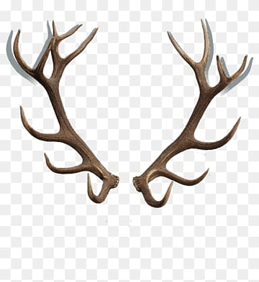
MRIGSHRINGA [HART’S HORN /DEER HORN]
Name – Mrigshiringa /Vishaana
Group –Sudha Varga

Slide 21
Description in Samhitas- The sushutra Samhita has explained that it has one of the material that act like shalya (su.sutr 26/22)
And in another two instances in kalpasthan
In sushutra chikitsa sthana he recommended the bhams of skin, hair and horn of quadrupeds for the growth of the hair follicles.
Synonyms –
Mrigshiringa , aenshringa , mrigvishana , harinshiringa etc.

Slide 22
SHODHANA of mrigshringa
Shodhana process of Mrigashringa, Ashuddha Mrigashringa boil with Takra or Kanji for 3 days and get shuddha Mrigashringa .

Slide 23
MARANA
Material Required : Mrigashringa , Arka kshira
Apparatus Required :Sharava Shamputa ,Mortar and Pestle
Heat Treatment : Gajaputa
Reference :Rasa Tarangini (12/105-07)
Procedure :
Make the small pieces of the antlers and burn them over chamber . the completely burn pieces were grounded to fine powder in a mortar and pestle. Levigate the powder with latex of Arka , prepare pellets , desiccate and encapsulate them. Subject the capsule to Gaja Puta. Repeat the process for 3 cycles. The resultant material will be black .

Slide 24
Bahirdhoom vidhi –
Shuddha mrigashringa heat in open air and convert into powder form than rub with arka ksheera and subject to puta for 3 times and white coloured Mrigashringa Bhasma.

Slide 25
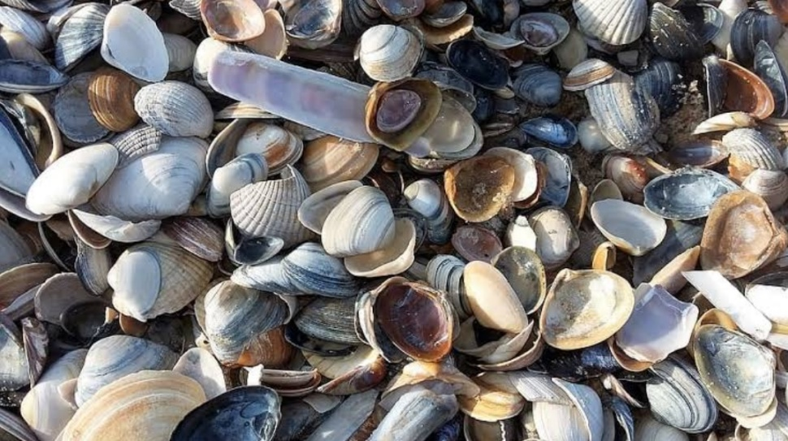
SHUKTI(MOTHER OF PEARLA)
Name – Shukti , Mukta Shukti
Group – Shudha /Shukla Verga
English name – Oyster Shell/Mother Pearl

Slide 26
Synonyms -
Muktashukti , Shukti , Mahashukti, Muktamata
Shuktika ,Muktagriha
According to Rasa Tarangini, shukti is of two types.
1- Mukta shukti .
2- Jala shukti .
Mukta shukti is available in the sea shores of southern parts of India and Srilanka.
Jala shukti is available in almost all ponds, rivers and also in the sea–
Properties - It has Katu and Madhura Rasa , Snigdha Guna .

Slide 27
Shodhana OF SHUKTI
Method - Swedana-
Material Required – Shukti , Jayanti swaras /Amla(acidic) liquid.
Apparatus Required – Dola yantra , Heating device
Reference - Rasa tarangini-( 12/65-66)
Procedure – Scrap the outer surface with knife to remove the debris. Bundle the shukti in a cloth and suspended it in Dola yantra , filled half of its volume with Jayanti swrasa /acidic liquid by means of rod . subject the apparatus to heating device and start boiling with mild heat. Continue the heating for 3 hours and monitor the liquid during heating constantly by replacing the lost liquid . finally collect the material and wash with hot water.

Slide 28
MARANA OF SHUKTI
Material Required – Shudhha Shukti
Apparatus required – Sarava Samputa
Heating system – Gajaputa
Reference – Rasa Tarangini 12/67
Repetition – One
Procedure - Reduced the purified oyster shell in to small pieces , encapsulate them using cupels and cement the joint . Subject the capsule to heating system following traditional / conventaional heating system . And finally collect the white Bhasma .

Slide 29
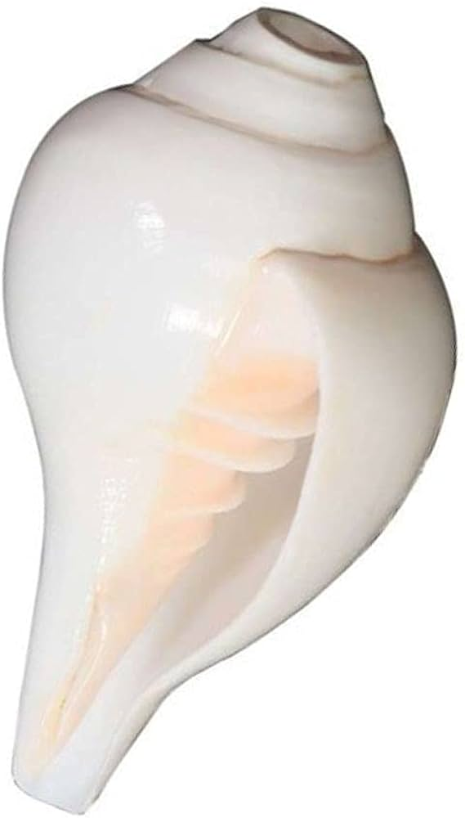
Shankha (conch shell)
Name –Shankha
Group –Sudha Verga
English name – Conch Shell
Synonyms –Shankha , Shankhaka, Kambu, Trirekha , Sunaada, Kamboja ,
Properties - Rasa :Kashaya ,katu ,Guna: Laghua sheeta and Virya sheeta.

Slide 30
Types –
Shankha is of two types -
Dakshinavarta shankha .
Vamavarta shankha .
Dakshinavarta shankha –
It is rarer variety of conch shell. Since it is not abundantly available, it is considered ausidered auspicious and used in temples to blow during prayers. Therapeutically, it can mitigate all the three doshas. It is believed to alleviate the poverty of the society.

Slide 31
b) Vamavarta shankha –
This variety of conch shell is abundantly available. It is the one, which is used for purification, incineration and for all the other compound formulation.

Slide 32
Shodhana of shankha
Method –Swedana
Material Required - Shankha ,Jambiri Nimbu Swarasa .
Apparatus – Dola yantra
Procedure -
Shankha is made into smaller pieces and those pieces are tied in a cloth like pottali. It is hung in a Dola yantra containing Jambiri nimbu swarasa as liquid media and subjected for swedana of four yama. Later the drug in the cloth is washed with warm water, dried and stored as shuddha shankha.

Slide 33
marana of shankha
Material required - Shankha
Apparatus required –Sarava Samputa
Heat treatment – Gajaputa
Reference –R.T (12/17-19)
Procedure -
The pieces of shuddha shankha are enclosed in sarava samputa. The samputa is sealed and dried under sun. later it is subjected for one gaja puta. When cool on its own, the drug material inside is taken in khalva yantra and triturated to fine powder form.

Slide 34
This powder is again enclosed in sarava samputa sealed, dried and subjected for another gajaputa. When cool on its own the white fine powder inside the sarava is collected and stored as shankha bhasma.

Slide 35
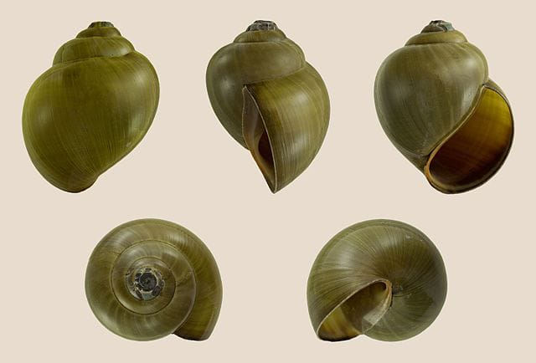
SHAMBUKA

Slide 36
SHAMBUKA
Name – Shambuka
Group - Sudha Varga
English name - pila
Synonyms – Shankhanka, Shambuka , Nakhshankha etc.
Properties – Rasa: katu kasaya , Guna : Tikshna , Virya : sheeta , Vipaka : Madhura
Karma – Deepana , Pachana , Grahi

Slide 37
SHODHANA (PURIFICATION) OF SHABUKA
Material Required – Ashuddha Shambuka , Nimbu Swarasa .
Appratus required – Gaja puta .
Reference – Rasa Tarangini ( 12/58 ) .
Procedure – shambuka has been taken in a clay pot with the nimbu swarasa or any other amla Dravya and has to be boiled for one and half hour to obtain pure shambuka .

Slide 38
MARANA (PROCESSING) OF SHAMBUKA
Materials Required – Shuddha shambuka , Kumari swrasa
Apparatus – Gaja Puta
Procedure – Shambuka has to be triturated with kumari swrasa and then it has to be sun dried and after that gaja puta has to apply to complete tha marana of shambuka and to obtain the Bhasma .

Slide 39
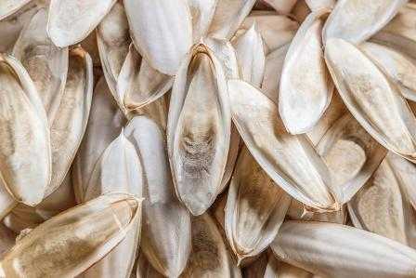
samudraphena
Name –Samudraphena
Group –Sudha varga
English name –Cuttle fish bone
Synonyms –Samudraphena,Phena ,Saphena, Phenaka , Abdhiphena

Slide 40
Properties – Shuddha samudraphena will have Kashaya rasa and sheeta virya.
Discription in Samhita - It has been prescribed for various aliment in allmost all major classics (samhitas) .
Where as Sushuruta has reffered it at several placec .
For arresting the excessive bleeding (S.S 14/36) .
Treatment of Kustha in the form of lepa (S.Chi. 9/10) .
As one of the ingredient in churnanjana in the treatment of shula (S .UT 12/51)

Slide 41
SHODHANA of samudraphena
Shodhana Methods- Bhavana
Material requird – Samudra phena ,Nimbu Swaras
Apparatus required –Khalva Yantra
Reference –Rasendra Chudamani/Rasa Tarangini
Procedure- Scratch the hard shell part on the dorsal side and take the soft part in a mortar and pestle.
Levigate it with lemon juice and desiccate the material and store .

Slide 42
Latest Research :The experiment was conducted to determine the feasibility of cuttle fish back bone as a new xenograft in the treatment of bone defects and prelimintry data on callus formation , osterogenic capacity and bone repairing suggest that cuttlefish neck bone could be considerd an alternative xenograft material in orthpaedic application . (Zafer okumus 2004)

Slide 43
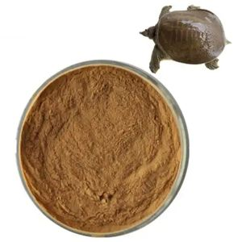
Kurmapristha
Name - kurmapristha
Group –Sudha verga
English name –Tortoise bone

Slide 44
SHODHANA OF KURMAPRISTHA
Take a small pieces of ashuddha Kurmapristhaand apply swedana (boil) with nimbu swarasa for 2 yama (6 hours) and get shuddha Kurmapristha

Slide 45
MARANA OF KURMAPRISTHA
Small pieces of shuddha Kurmapristha keep amidst kumari swarasa and subject to puta, collect and again rub with kumari swarasa and again subject to puta for 2 times and collect white coloured Kurmapristha bhasma .

Slide 46
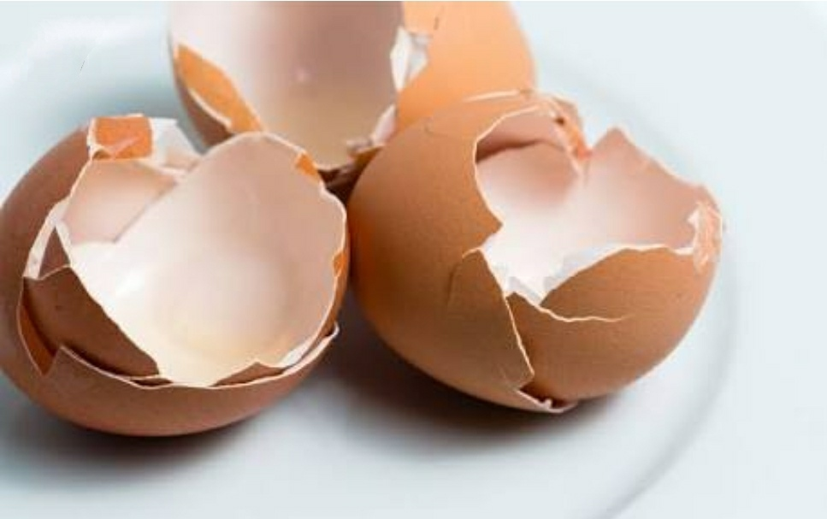
Kukkutanda tawak
Name –Kukkutanda Twak
Group – Sudha varga,
English name –Egg shell

Slide 47
Shodhana OF KUKKUTANDATAWAKA
Method –Nimajjan and Kshalan
Material Required –Kukkutanda Tawaka 1 part Navasadar 1/8th part and Saindhava Lavan 1/8th part
Procedure –Dissolve the Saindhava lavan and Navasadar in the said proportion in water and step the shell in the water and allow to stay for 4-5 days
Remove the inner membrane and wash with water

Slide 48
MARANA of kukkutanda tawaka
Sawedana -
Required material–Shuddha kukkutanda Tawak , Kumari Swaras
Apparatus – Khalva Yantra , Sharava (puta) yantra .
Repetition - 3 cycle
Procedure – Grind the Shuddha Kukkutanda Tawaka to fine powder by taking them in a mortar and pestle.
Levigate with Kumari Swarasa, prepare pillets and desiccate them in shade.
Encapsulate the pellets in earthen soccers ,seal the joint and subject the capsule to Gaja puta .
Collect the material on anneling and repeat the process for three time .

Slide 49
DOSE AND ADJUVANT ( ANUPAN )
VARGA
DOSE
ANUPAN
Sudha
Khatika
Godanti
Shawetanjana
Mringashiringa
Shukti
2 –Tola
1 year child 30-60 drop
b) 1/2 to 1 masha
c) 1-3 Ratti (Rasatarangini)
1-2 Masha(rasamritama)
d) According to Godnti
e) 1-2 Ratti
f) 2 Ratti
………
Water
c) Honey , milk, Cow Ghrita
d) According to Godanti
e) Honey , Ghrita , Milk, Navaneet
f) Honey , Ghrita , Milk

Slide 50
VARGA
DOSE
ANUPAN
g) Shankha
h) Shambuka
i) Samudraphena
j) Kurmapristha
k)kukkutandatawaka
g) Nimbu swrasa, hot water
h) Nimbua Sawrasa , Hot water
i) Honey , water
j) Honey, Guduchi satwa
k) Navaneet , Sharkara , Milk , Honey
g) 2 Ratti
h) 2 Ratti
2 Ratti
j) 2- 4 Ratti
k) 2-4 Ratti

Slide 51
FORMULATION
Sudha Varga
Formulation
Churnaodaka
Khatikaadi Peya
Dashansansakara Churna
Mugdha Ras
Godanti Bhasma
Balapanchabhdra rasa
Muktavati
Shankhadarawaka rasa
Kaparda sundar rasa
Jawaharmohra vati
Jawarankush rasa
Trinetra etc .
a) Sudha (chuna)
b) Khatika
c) Godanti
d) Mrigshiringa
b

Slide 52
Pravalpanchamruta rasa
Visamajwarantak rasa
Garahnishardula rasa
Agnikumara rasa
Agnisandeepana rasa
Kaphaketu rasa
Mahashnkha vati
Shambuka Bhsma
Samudraphena Bhasma
Kurmapristha Bhasma
Kukkutanda Tawak Bhasma
e) Shukti
Shankha
g) Shambuka
g) Samudraphena
h) Kurmapristha
i) Kukkutanda tawaka

Slide 53
CLINICAL USE
Sudha (Churnodaka )
Is indicated for Basti, Sevana and Kavala apart from its preparation of Kshara (alkali) . Sudha Khatika along with cold water pravahika , Pittasra and Grahani.
Khatika Bhasma
Daha, Raktvikara , Raktsarava Rodhaka , Grahahani, Netraroga .
Useful to mitigate Pitta, Burning sensation , Ulcers etc.

Slide 54
Godanti Bhasma
Arrest bleeding and ameliorates hyperacidity. It helps in healing of ulcer in acid-peptic disease. In burning sensation of body Godanti Bhasma is the choicest remedy. It arrest bleeding in diarrheoa and dysentery.
Mirigshiringa
Hritshula (angina). parshvashula, Jvara, Kasa, Shwasa, Balya, Kantivardhaka etc.
Shukti
Useful in abdominal colic. It act as antidote, carminative and digestive.

Slide 55
Shankha Bhasma
It is indicated in gastrointestinal disorders like Amla Pitta, Parinama Shula, Grahani (Irritable bowel syndrome) and Agnimandhya which is clinically proved. Useful in hyperacidity, dyspepsia and gastro - esophageal reflux .
It is balya strength. It is usefull in Tarunya Pidika (acne vulgaris) .

Slide 56
Sambuka Bhasma
Is useful in udar shula (abdominal colic), hyperacidity and Atisar (diarrhea), Netra roga (eye diseas) .
Samudraphena
It enhances the intestinal motility (sara guna). It is useful in all types of netraroga as it is chakshusya. It is good appetizer. It dries up the infectious secretions from ears and good against visha dosa. It has kashaya rasa, mitigates kapha dosha and is useful in all types of kushtha roga .

Slide 57
Kurmaprishtha,
It is very useful for bala and it gives strength to bone.
Kukkutanda Tawak
Hridya, Balya, Mamsa vardhaka, Vajikara, Prameha , Shukravikar Impotency , Menorrhagia Leucorrhoea ,

Slide 58
Sikata varga
Name : Sikata
Group : Sikata,Parthiv
Modern : Silicate
Discription in Samhita :It has been found mentioned in major classics like Charak , sushruta and Asthanga Sangrah etc .

Slide 59
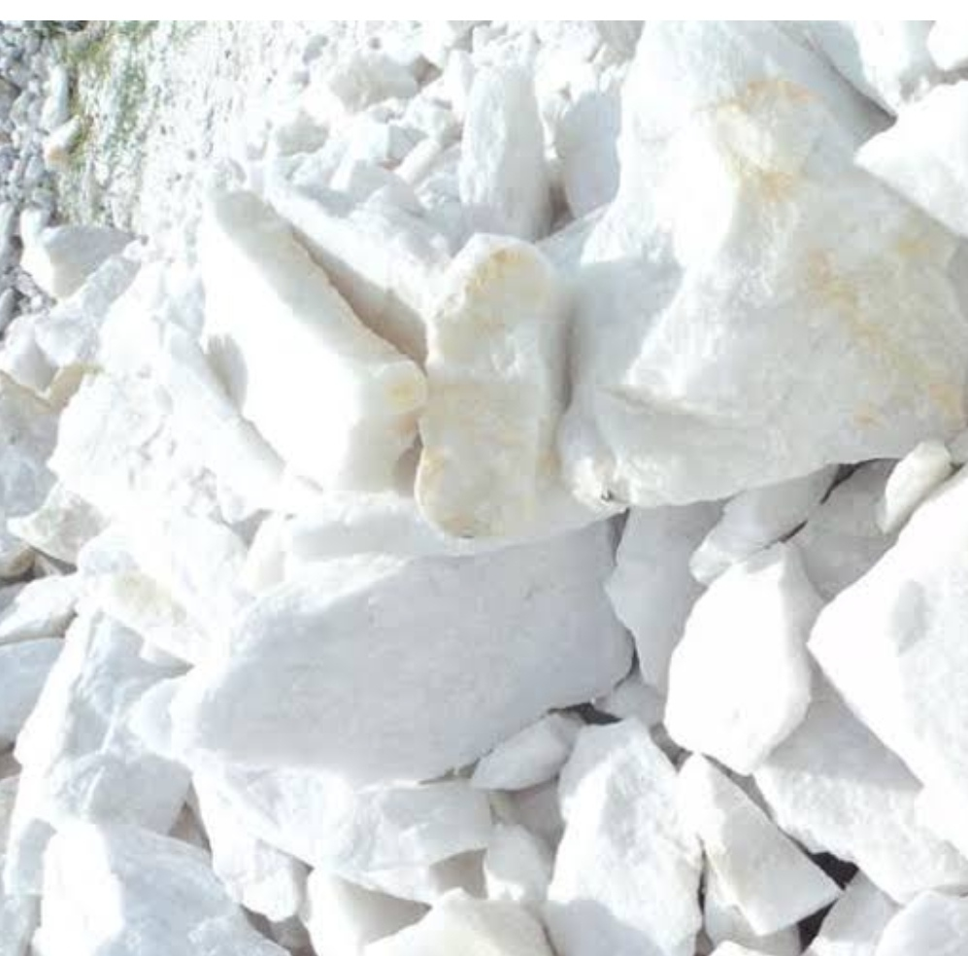
Dugdha pashan
Latin Name: Dugdha Pashan
Group: Silicates
English Name : Talcum, French chalk, soft stone

Slide 60
Availability of Dugdhapasana – It is found in Italy, France, Germany, Switzerland, New Zeeland
Synonyms : Dugdha pashana, Dugdha pashanaka, Dugdha, Dugdhi, Dugdha Shila, Ksheera Kshava, Vajrabha, Deeptika , Soudho , Gomedha Sannibha, Dugdhopala, Dugdha Drushad .

Slide 61
PROPERTIES
Rasa: Madhura
Guna: Snigdha , Sheeta
Verya: Sheeta
Karma: Grahi , Vrana Ropaka , Raktastambhana, Danta Roga hara

Slide 62
Marana OF DUGDHAPASHAN
Levigate Dugdha Pashan in Satapatri Rasa, prepare pellets, allow them to dry, encapsulate them and subject the capsule to graded heating system by applying Gajaputa.

Slide 63
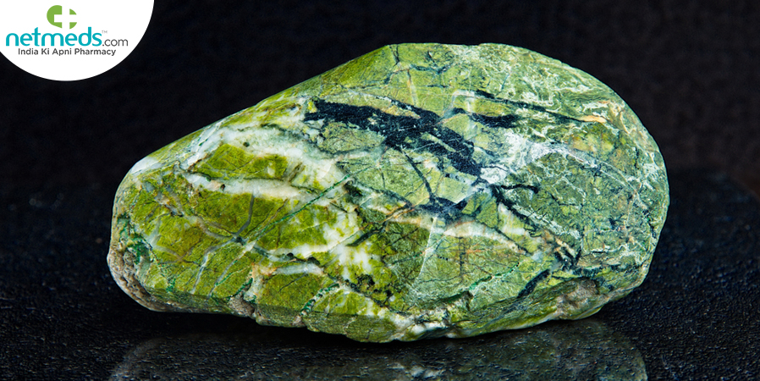
Nagapashan
Name : Nagapashan
Hindi name : Jaharmohra
English name : Ophite/Serpentine

Slide 64
Nagapashana: Nagashama is Available in China, Tibbet, Laddakh , Garhwal and Nepal mountains .
Colour: Harita (green), Peeta (yellow) and Swethabha Yukta Varna (White)
Synonyms: Nagapashana, Nagashma

Slide 65
Properties:
It acts as Medhya (Intellect promotor), Saumanasya janana (Attractive), Mastishkya (Neuro-tonic), Yakrith balakar (tonic for Spleen), Ojovardhaka (Immuno boster), Visha hara (Antidot), Atisara hara (Antidiahrreoal), Hrudhaya dhourbalya hara (Cardio-tonic) and Vamanahara (antinauseatic)

Slide 66
Shodhana and Marana :
Both these procedures are not mention due to there is no requirement.
Pishti
Material required :
Shuddha Nagpashan ,Rose water
Apparatus required :
Kharal Yantra
Nagapashana is to be triturated with Taruni Jal (Rose water), for 3-4 days.

Slide 67
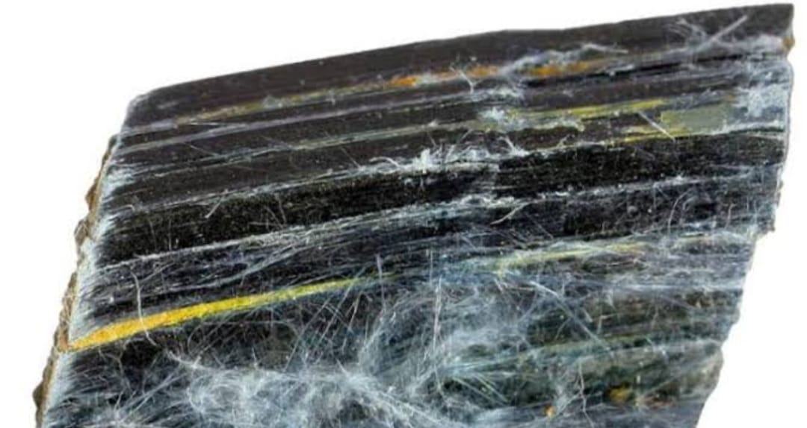
Kausheyashma
Name : kausheyashma
Group : Sikata varga
English : Asbestos
Hindi : Resmi patthar
Properties: Verya: Sheeta and Raktastambak .

Slide 68
Shodhana:
This process is not mention due to there is no requirement .
Bhasma:
Kausheyashma is triturated with kumari swrasa and kept in Sarav samput (Mud smeared cloth earthen pot), subjected to Gaja Puta . After 5 to 8 Puta we obtain white colour Bhasma
Pishti:
Fine powder of Kausheyashma, triturated with rose water, for 3-4 days

Slide 69
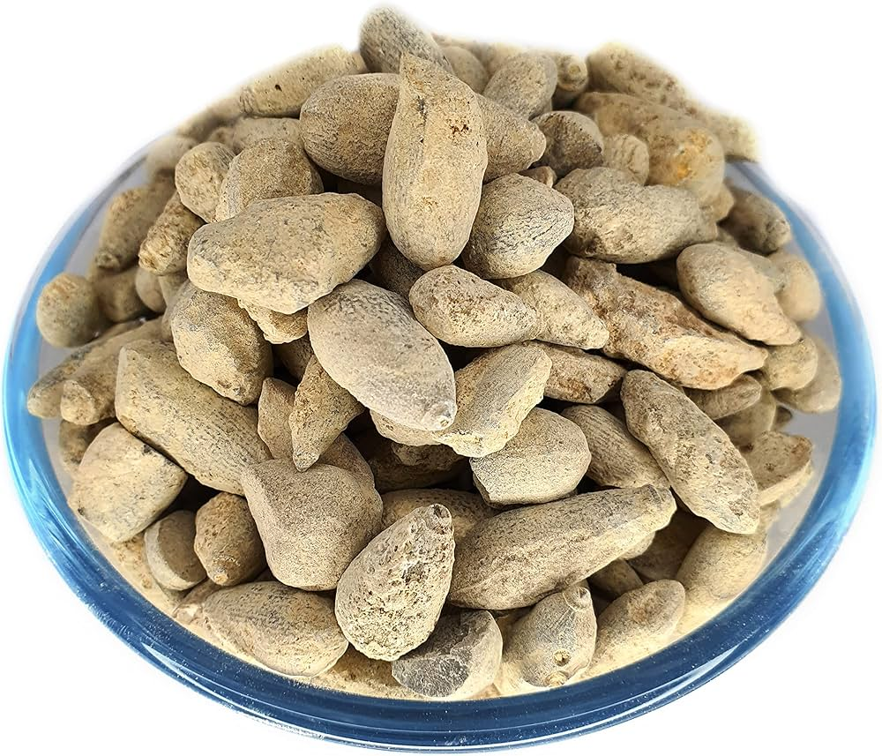
Badarashma
Name – Badarashama
Group – Sikta Varga
English name – Silicate of lime

Slide 70
Availability of Badar-Pashana is in Arab, Seria, Mishra, Iraq, Afghanistan, Jordan, India and Pakistan.
Synonyms – Badrashama , Ashmabhida , Pashanabadara , Badripashana
Colour: It is brownish in out-side and greenish white from inside

Slide 71
Shodhana OF BADRASHAMA
Methode-
Marerial Required –Badarashama ,Mooli swaras , Kadlikanda swrasa
Apparatus Required – Heating device, Vessels , Iron pan .
Procedure –
It has to be heated red hot and then dipped in decoction of Kadlikanda Swarasa (Juice of Musa paradisiaca L.) or in radish (Raphanus sativus L.) juice for 7 times, taking care not to allow the pieces to get shattered.

Slide 72
MARANA
Levigate the material with the addition Mooli Swarasa in a mortar and pestle. Encapsulate the pellets and subject the capsule to heating system. Collect the material on annealing.
Grade of Heating : Gajaputa
Repetition : Repeat the process for 7 cycles.
Pisthi:
Levigate the material by taking them in mortar and pestle with the addition of rose water repeated till the material becomes very fine.

Slide 73
VARGA
DOSE
ADJUVANT
Dugdhapashan
Nagapashan
Kausheyasma
Badrashama
………
Shahad , arka gulab
Arka kevda , dugdha
Shahad , dugdha
Shahad , kalikanda swrasa ,mooli swrasa ,jal ,dugdha
1 – 2 Ratti
2 – 8 Ratti
2 – 4 Ratti
4 – 8 Ratti

Slide 74
CLINICAL USE
Dugdhapashana – Grahi ,
Varanaropan (Wound healing )
Dantroghar ( Dental disorder )
It is usefull in curing jawara (Fever ), Adhman , Kasa ( Cough) Sawas (Respiratory disorder )
Nagapashana – It is said to be useful in preventing the emesis .
It also said to be specifically useful in cardiac aliment .
Ojoverdhaka ( Immune Modulator ) , Vishahar ( Antidote )

Slide 75
Kausheyashma –
Dantamanjan (Tooth powder) is preparing with Kousheyashma as ingredient, indicated in teeth and gum problems (Danta Rogas, Danta Shithilya, Danta Puya).
It is also used in Raktodgama (Bleeding disorder), Puyodgma, Pyorrhoea, Prameha and Pradara Roga (Dysmenorrhea) . It cures Fever, Asthma and Cough .
Badarashama – It is said to be -
Mutral ( Diuretic )
Vaman nashak ( Antiemetic)
Mutrakricchra ( Dysuria )
Mutraghata ( Urine Retension )
It is also said to be useful in Mutrashmari ( Urinary Calculi )

Slide 76
MODERN PROSPECTIVE OF SUDHA VARGA
Sudha Vargiye Dravya mainly contains calcium compounds chiefly calcium carbonate (CaCO3), calcium oxide ( CaO ) and some amount of calcium silicates. Calcium carbonate is widely used in the treatment of peptic ulcer.
It is a fast acting antacid and reduces gastric acidity resulting in an increase in the pH of stomach.
Calcium being the main ingredient plays an important role in many physiological activities not only related to bones but also includes Blood Clotting, Nerve Conduction, Muscle Contraction, Regulation of enzyme activity and Cell Membrane function .
It takes part in production of many enzymes and hormones which regulate digestion process and metabolism

Slide 77
Calcium is essential for the normal transport of nutrients through membranes, Blood coagulation and Muscle functioning .
It prevent blood loss if ulcers are bleeding, heal the ulcers by muscle contraction and hardening and also reduces the pain by regulating nerve function and perhaps most importantly, Calcium is the main buffer used in the body to neutralize acids and maintains the proper pH .
Stimulation of acid secretion by the parietal cells occurs by at least three major pathways: the cholinergic transmitter such as acetylcholine, histamine, which is locally released in the gastric epithelium and the hormone gastrin .

Slide 78
Shankha Bhasma acts like antacid.
Its acid neutralizing capacity, speed of antacid action and prolonged buffering action were excellent. Shankha Bhasma causes noteworthy decrease in ulcer index in both the indomethacin and cold resistant stress models for studying Peptic ulcer disease.
Study revealed that Mukta Bhasma rendered dose dependent protection produced significant protection in cold restraint stress induced gastric ulcer and diclofenac induced ulcer in low doses of therapeutic range when compared with control.

Slide 79
Thio barbituric acid reacting substances of stomach in ulcer induced rate was also by Mukta Bhasma .
The study conducted to assesses the effectiveness of Pravalapanchamrita (formulation containing Mukta Bhasma, Shankha Bhasma, Shukti Bhasma, Varatika Bhasma and Pravala Bhasma) in patients of Amla Pitta and conclude that it is a highly effective medicine .

Slide 80
CONCLUSION
Sudha varga plays important role in Ayurvedic therapeutics as well as modern medical scenario.
Sudha varga (calcium compound) in all disease related to calcium and gastro instestinal disorders. So with its proper use, success can be achieved on many diseases in the future.
In context to the present review, it can be concluded that the ingredients of Sudha Varga Darvya can be regarded as the contributing factors in the treatment of peptic ulcer, gastric ulcer, IBS etc. It is worthy of exploring the opportunity of employing the therapeutic advantages of Sudha Varga Darvya.

Slide 81
Medicinal use of Sikata varga starts since Samhita Period. But in the various texts book of medieval period considerable use of Sikata or silicate containing used in treating disease and iatrochemistry. A separate group of Sikata along with group of metals and minerals were found place in classical text of Rasa Shastra. But name and counting of Sikata members arevaried in all text

Slide 82
REFFERENCES -
Sharma Sadananda, Rasa Tarangini, edited by Shastri Kashinatha, 11th ed. Motilal Banarasidas Delhi. 11/223–229, (1989). 28.
Trikamji Yadavji Acharya, Rasamritam, trans by Joshi Damodar, 1st edition, chaukhamba Sanskrit Bhavana, Varanasi:, page no.-122, (1998) .
Mishra Siddhinandan -Ayurvediye Rasasastra, chaukhamba orientalia, Varanasi, chapter-Sudha Varga, p.no.-571, 2007

Slide 83
Reddy KRC, The text book of Rasashastra, 1edtion, Varanasi, Chaukhamba Sanskrit Bhavan, 2007, P522- 24
.Pandey Z. G. A pharmaco–clinical study of Shankha Bhasma alone and Shankha Bhasma along with Amalaki Churna in the management of Amla Pitta, Post Graduate dissertation, IPGT and RA, Gujarat Ayurved University, Jamnagar (2000).
.Murty K.R. Srikanta, Editor Sarangdhara Samhita by Sarangdhara, Chaukhamba Orientalia: 2010, P266-67.
Murty K.R. Srikanta, Editor Sarangdhara Samhita by Sarangdhara, Chaukhamba Orientalia: 2010, P251

Slide 84
Ravindra angadi, 1st edition, the text book of rasa shastra, chaukhambha praksahan, 2016; page no. 364
Trikamji Yadavji Acharya, Rasamritam, trans by Joshi Damodar, 1st edition, chaukhamba Sanskrit Bhavana, Varanasi:, page no.-119, (1998)
Sharma, S. (2014). Editor, (Reprint 8th ed.). Rasatrangni, Chapter 11, Verse 234-236. Varanasi: Motilal bnarashi dasa, 282-283.
Shawami, B., Rasa, D., Sudha, D. Vigyaniya: Chapter 9, Rohtak: Naath Pustak Bhandaar, 343
Jha, C.B., editor, (Reprint ed.). (2010). Ayurvediya Rasashastra, Chapter 9, Varanasi: Chaukhambha Subharti Prakashan, 447.

Slide 85
Loevenhart, S. and Crandall L. A. Calcium Carbonate in Treatment of Gastric Hyperacidity Syndrome and In Gastric and Duodenal Ulcer; JAMA; 88(20):1557–1559. (1927)
Meletis Chris D., Zabreskie Nieske, and Rountree Robert Clinical Natural Medicine Handbook. Mary Ann Liebert, Inc.publishersp.213 Available Onlinehttp: //www.liebertpub.com/dcontent/files/samplechapter s/ Sample_Clinical Natural Medicine Handbook.pdf (2008)
Akhter Mymoona, Gastrointestinal Agents, Available Online. http://nsdl.niscair.res.in/bitstream/12345689/707/1/revised+Gastrointestinal+agents.pdf. (2007)
Piste Pravina, Didwagh Sayaji and Mokashi Avinash, Calcium and its Role in Human Body. International Journal of Research in Pharmaceutical and Biomedical Sciences; 4 (2):659– 668. (2013)
Dubey N, Mehta RS, Saluja AK, Jain DK, Antiulcer activity of a traditional pearl preparation: Mukta Bhasma, RJPT, 2:287-90.(2009)
Chauhan Omi, Ghelot A, Rathore R, Chaudhary R, Anti peptic ulcer activity of MuktaShukti Bhasma, Pak J Physio, 6:20-31.(2010)

Slide 86
An International Journal of Research in AYUSH and Allied Systems
AYUSHDHARA | March - April 2016 | Vol 3 | Issue 2 602
A THERAPEUTIC APPROACH OF SUDHA VARGA DRAVYA WORK STATUS RELEASE TO GASTROINTESTINAL DISORDER
Vivek Thakur * P.G. Scholar, Professor, Department of Rasa Shastra & Bhaishjya Kalpana, Uttarakhand Ayurveda University, Gurukul Campus, Haridwar, Uttarakhanda, India.
Ph.D. Scholar, Department of Dravya Guna Vigyana, Faculty of Ayurveda, I.M.S, B.H.U, Varanasi, India.
Critical review on Sudha varga and its therapeutics use – Deepak kumar Tiwari M.J.P. Rohailkhand University
Sikta varga (silicate containing compound ) in ayurvedic medicine
Article – January 2021
Yadevendra Yadav Uttrakhand Ayurved University , Dehradun

Slide 87
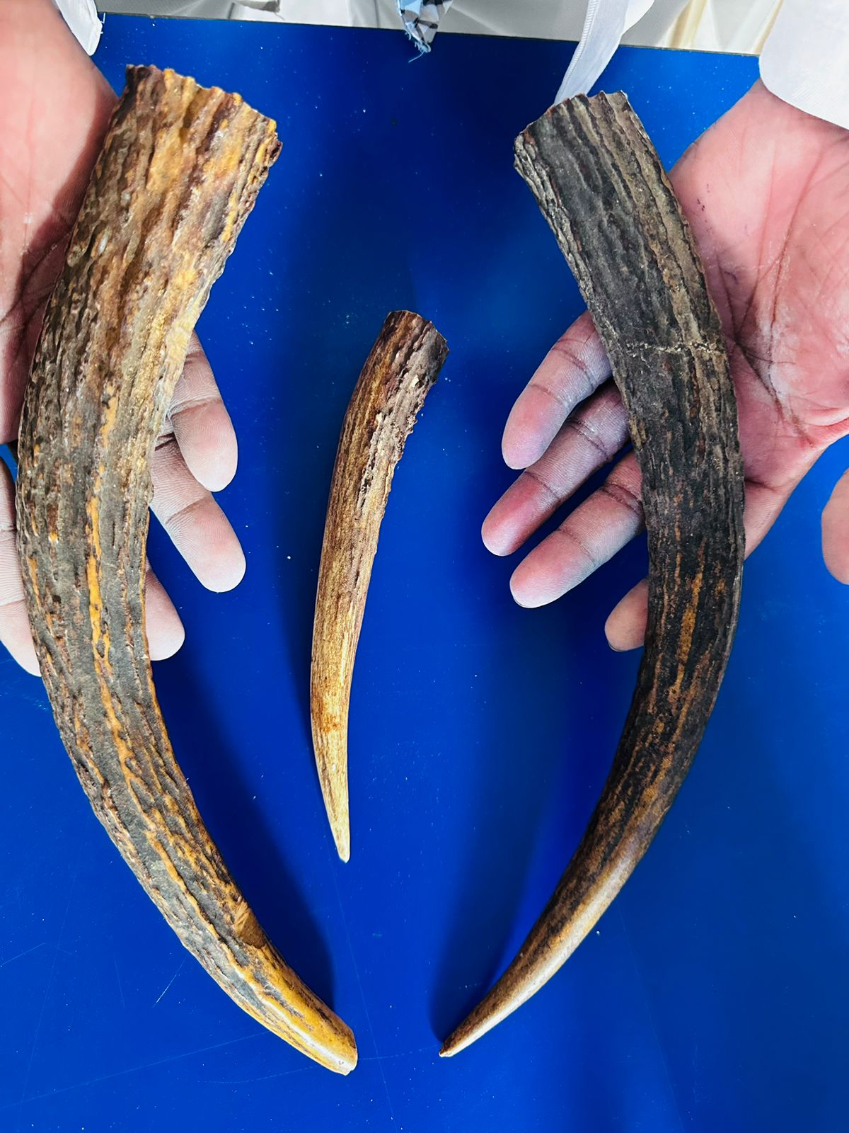
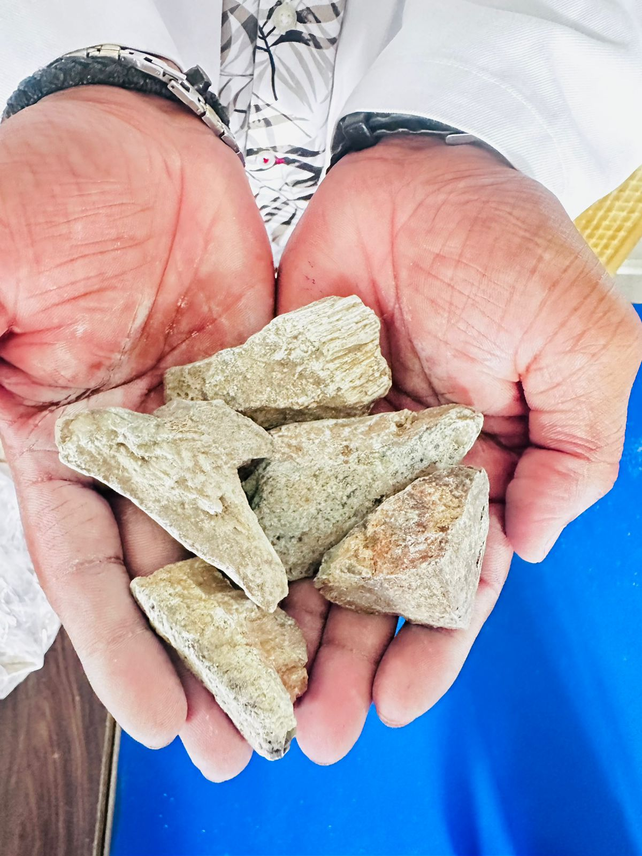
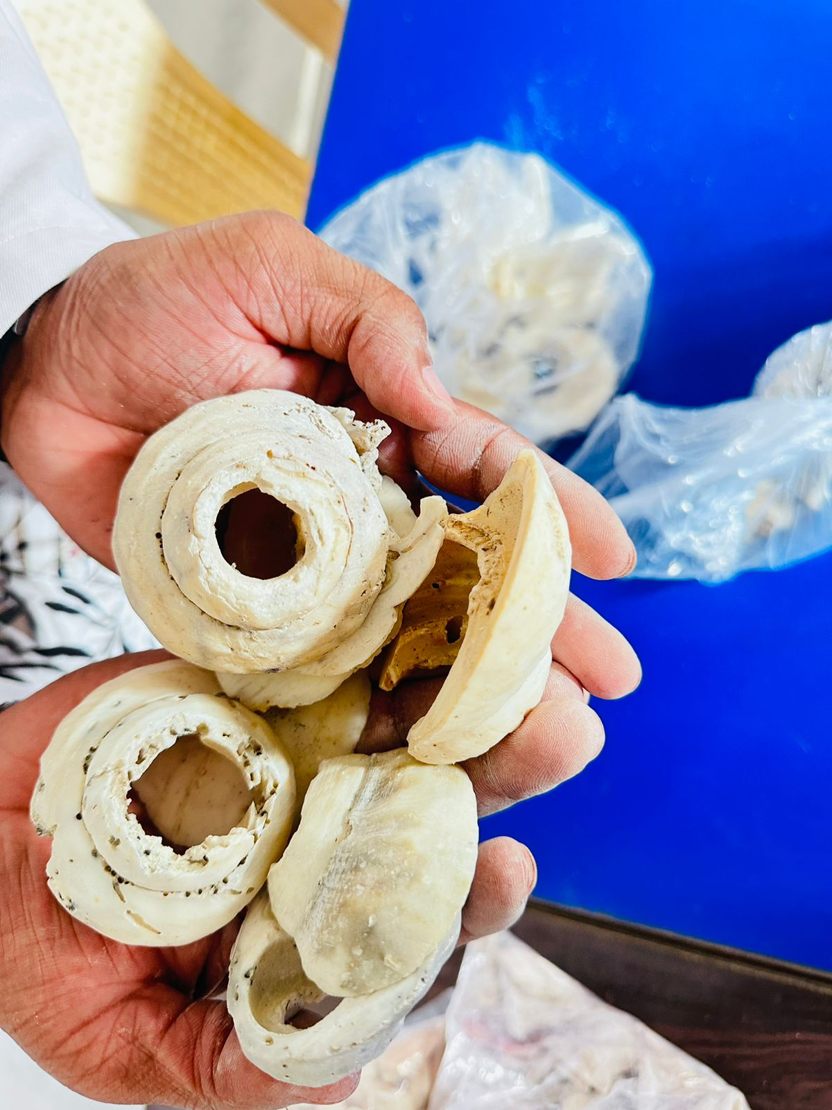
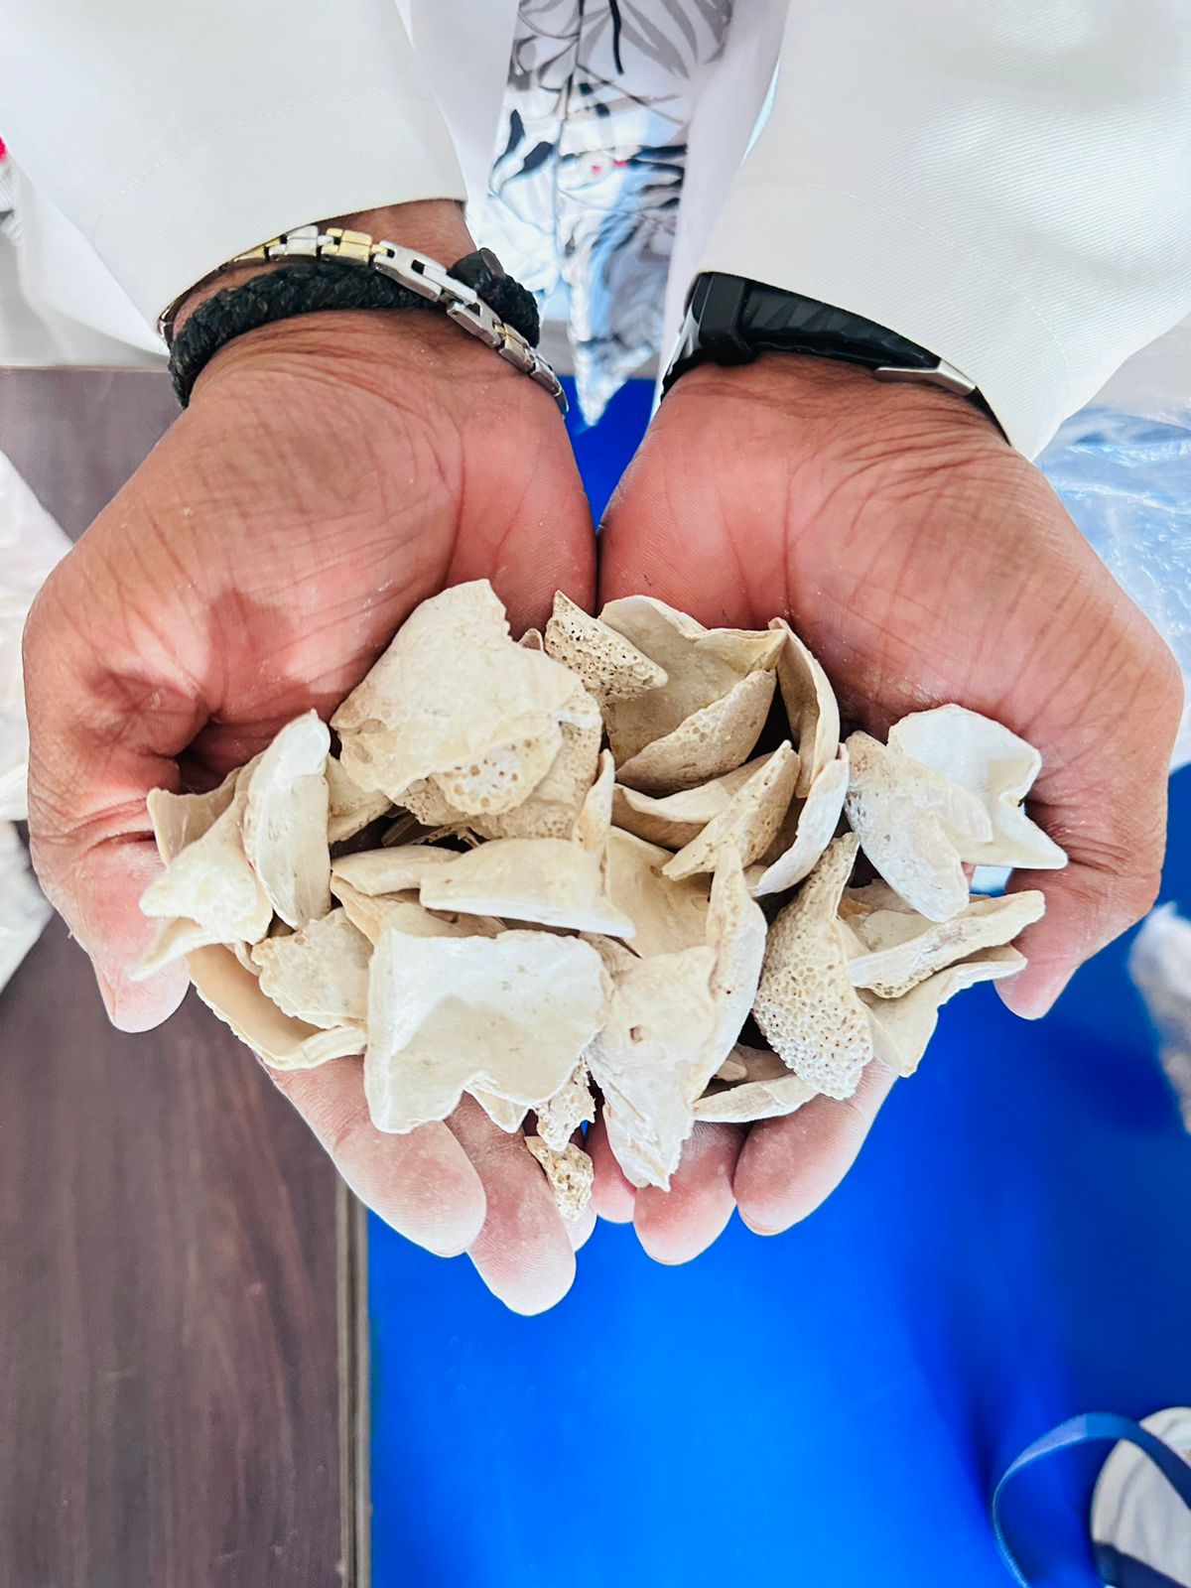
mrigshiringa
nagpashan
shankha
shukti

Slide 88
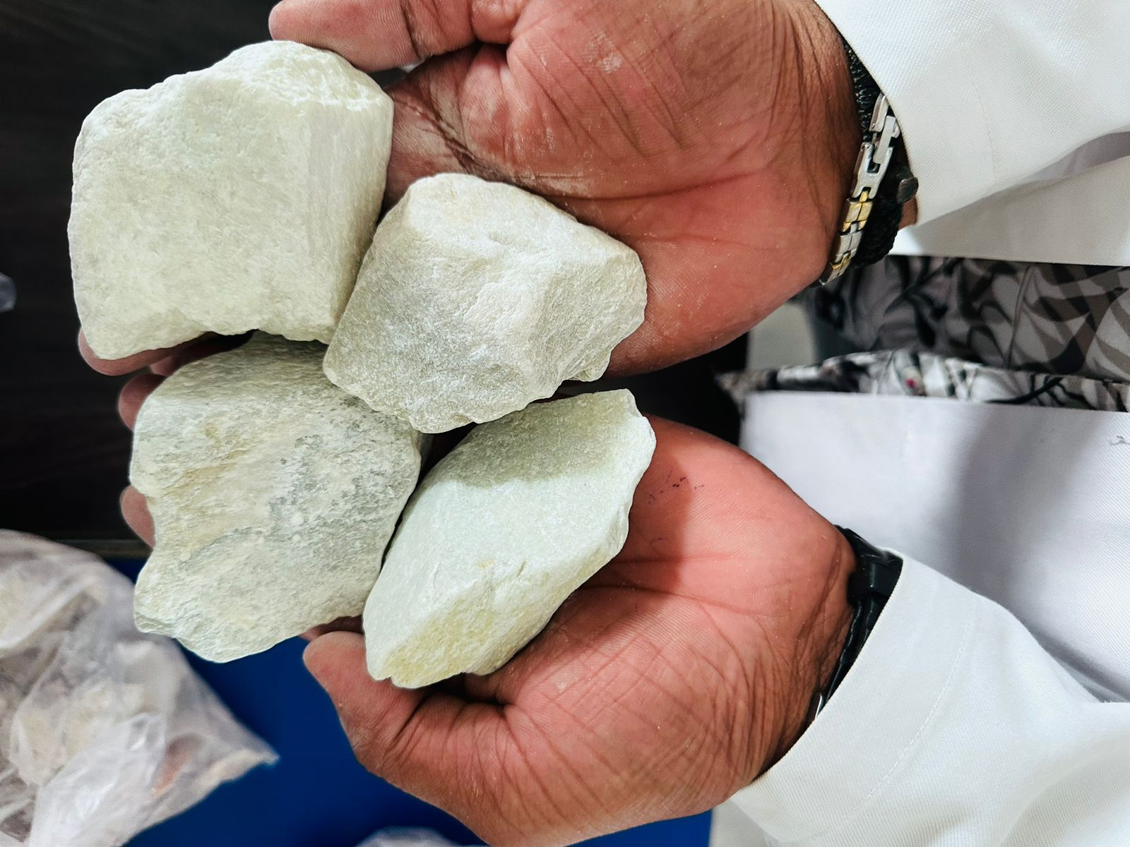
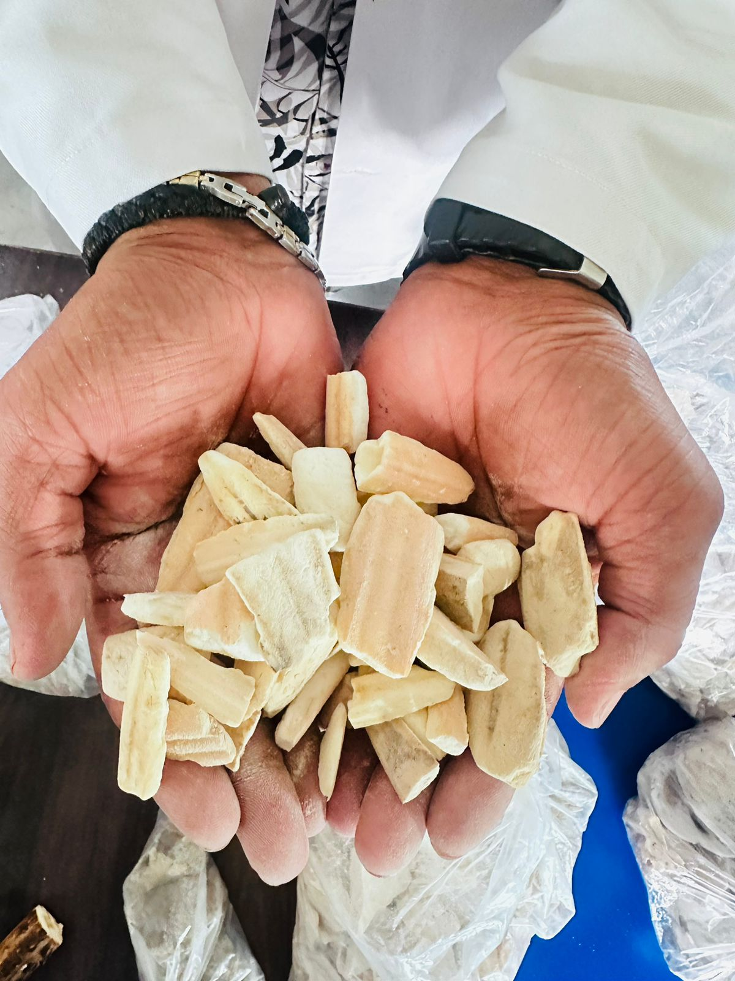
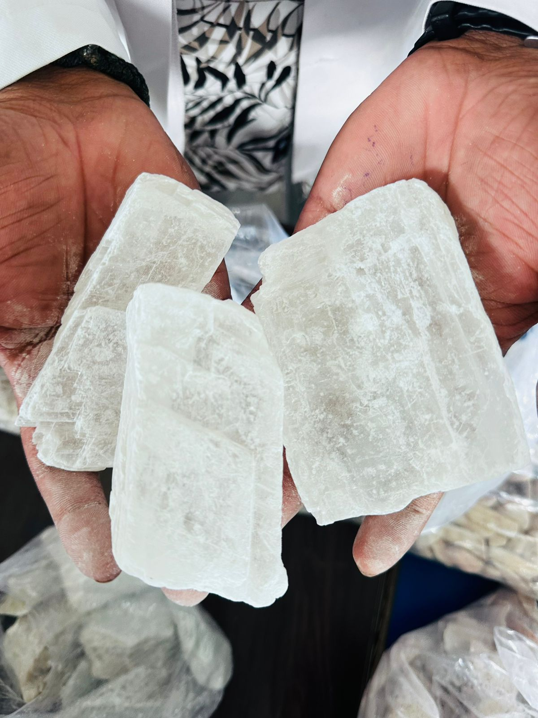
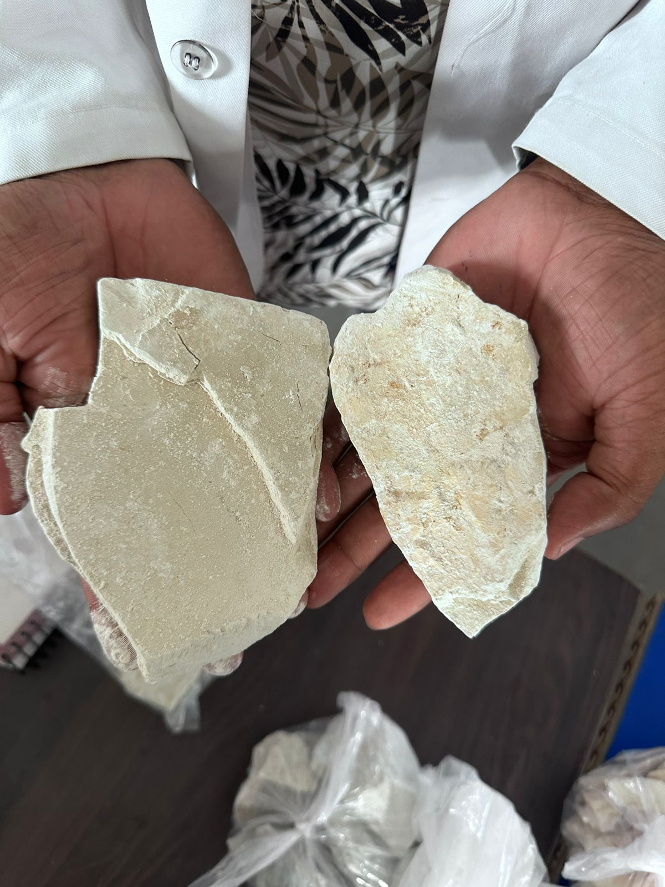
chuna
samudraphena
godanti
khatika

Slide 89
THANK YOU

